Slide 1
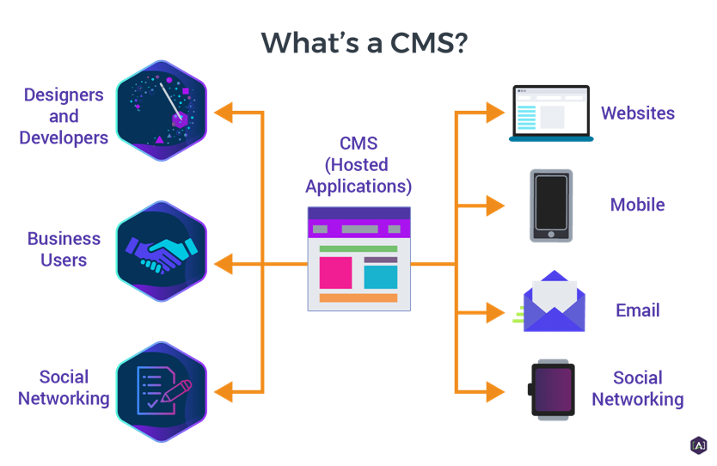
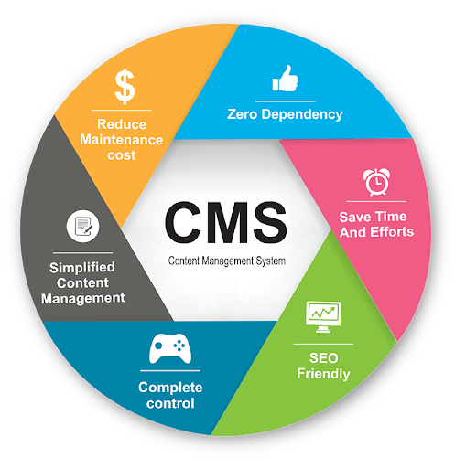
A Simple Way to Create Professional Web Pages Without Writing Code Using a Content Management System (CMS)

Slide 2
Content Management System (CMS) continue
What Is a CMS?
A content management system (CMS) is a software application that handles the basic infrastructure of creating websites. With a CMS, users can focus on the front-end areas of website building, such as customizing the website design and managing content.
There are multiple types of content management systems available. Three of the most popular ones are:
Open-source CMS – a community of developers maintains the software instead of a single company owning it. Third-party developers have access to the source code and can develop and improve the software’s functionalities.
Cloud CMS – a pre-built system accessible without having to download hardware or software. Users can manage web content safely over the cloud and have it be easily accessible from multiple devices.
Proprietary CMS – comes with a license fee as it is the legal property of a company, organization, or individual that created it. The cost can be a one-time initial payment, a monthly fee, or an annual charge.

Slide 3
Content Management System (CMS) continue
What Is a CMS?
A content management system (CMS) is a software application that handles the basic infrastructure of creating websites. With a CMS, users can focus on the front-end areas of website building, such as customizing the website design and managing content.
There are multiple types of content management systems available. Three of the most popular ones are:
Open-source CMS – a community of developers maintains the software instead of a single company owning it. Third-party developers have access to the source code and can develop and improve the software’s functionalities.
Cloud CMS – a pre-built system accessible without having to download hardware or software. Users can manage web content safely over the cloud and have it be easily accessible from multiple devices.
Proprietary CMS – comes with a license fee as it is the legal property of a company, organization, or individual that created it. The cost can be a one-time initial payment, a monthly fee, or an annual charge.

Slide 4
How Does a CMS Work?
To understand how a content management system works, you first need to know what makes a website and how to build one from scratch.
A website consists of two main parts ‒ the front-end and the back-end. The front-end is the part an end-user sees in their browsers, such as blog posts, galleries, and videos. It comprises standard markup languages called HTML, CSS stylesheet language, and JavaScript.
Meanwhile, the back-end consists of the database and the functionality of a website. Different programming languages that are used in its construction are PHP, Python, Ruby, and Java.
To make your website visible on the web, you also need to manually upload all of your website content into a web server.
The web server database will store your content and push it from the back-end to the front-end whenever a user accesses your site.

Slide 5
How Does a CMS Work continue
A content management system lets you streamline these processes. Besides eliminating the need to code, a content management system also makes uploading content easier.
The user-friendly content editor allows you to create content like posts and pages hassle-free. Besides text-based files like .PDF documents, the content editor software also lets you organize web pages, images, videos, text, and audio files, among other different file types.
Most CMS software also provides you with an interface through which you can have revision control. You can also use it to configure the settings of your website and set permission systems. The entire process is beginner-friendly and requires no technical knowledge.
Keep in mind that a content management system is different from an enterprise content management system (ECM). The ECM focuses more on document management and business-related processes, such as digitizing paper documents for better organization, security, and traceability.

Slide 6
Plugins, Extensions, and Themes
By default, content management systems allow you to create posts and pages and modify the overall design of your website. Additional features like search engine optimization (SEO), search functions, security, and other customizations are available via extensions such as plugins and themes.
An extension or a plugin is a software component that carries a specific functionality. Adding it to a website will expand its capabilities or integrate the website’s system with a third-party service.
Most CMS platforms have their own extension or plugin directories. For instance, WordPress has thousands of free plugins in their official plugin directory. Some CMSs also let you purchase them from third-party plugin marketplaces like CodeCanyon and Mojo Marketplace.

Slide 7
Plugins, Extensions, and Themes continue
As for changing your website’s appearance, you can do so by installing a theme. It’s a bundle of template files that provide a site with a consistent visual interface without affecting its core functionality.
Keep in mind that a theme generally caters to a specific niche when it comes to the design and functions. However, you may edit the files to add or remove some visuals and graphics and modify the color scheme.
Like plugins, themes are available for download via the CMS’s theme directory or third-party marketplaces.
The installation process of both components is relatively straightforward. Configuring and modifying them may need some basic technical knowledge, but they’re easier to learn compared to learning how to code from scratch.

Slide 8
Popular Content Management Systems
As each CMS platform targets different user needs, it’s essential to figure out your goals for the end result. The following are some of the most popular web content management system (WCMS) platforms to consider.
WordPress.org

Slide 9
Popular Content Management Systems continue
Powering 42.9% of the internet, WordPress is the most popular web content management system on the market today. This free, self-hosted CMS started as a blog publishing platform, which left it with robust content management tools.
WordPress can accommodate all kinds of websites, from eCommerce stores, to learning sites, and simple portfolios.
It comes with a massive collection of plugins and themes that are relatively easy to configure. For this reason, WordPress is highly versatile and scalable.
Being an open-source platform means WordPress has a large community and plenty of forums. Website owners can connect with other WordPress users or refer to WordPress tutorial websites for assistance.
This is especially beneficial for beginners since WordPress has a steep learning curve.

Slide 10
Popular Content Management Systems continue
Drupal

Slide 11
Popular Content Management Systems continue
Drupal is one of the most powerful web content management systems in the market. Large businesses and government entities like NASA, Tesla, Sony Music, and Nokia use it to manage their web content online.
Drupal features excellent page load time and advanced security tools. It also comes with built-in modules, allowing you to integrate your website with popular analytics tools, as well as marketing and eCommerce features.
That said, you just need Drupal hosting services and basic coding skills to build a website with Drupal. This CMS platform is designed for professionals, so beginners may find its interface much more complicated than WordPress.

Slide 12
Popular Content Management Systems continue
PrestaShop

Slide 13
Popular Content Management Systems continue
PrestaShop is an increasingly popular content management system for small to medium-sized eCommerce businesses.
One of the benefits of using this CMS software is the simple onboarding process and access to user-friendly eCommerce tools, which allow users at all skill levels to create a professional online store.
Besides being easy to use, PrestaShop also supports multiple currencies and languages. SEO tools are also available to improve your store’s ranking on SERPs.
However, Prestashop’s limited scalability makes it not suitable for large-scale businesses. You will need to buy premium modules and templates to scale your store. Also, reliable hosting for Prestashop will be needed to get your site up and running.

Slide 14
Popular Content Management Systems continue
Magento

Slide 15
Popular Content Management Systems continue
Magento is a popular eCommerce platform for medium to large-scale online stores. Samsung, Nike, and Ford are a few among many large companies that use Magento because of its scalability and advanced customization options.
Magento comes in two versions ‒ open-source and Commerce. The free, open-source version comes with plenty of features, like global selling, site search, and catalog management.
To access premium functions and support, you have to purchase the Commerce version of Magento, the cost of which depends on your individual needs.

Slide 16
Popular Content Management Systems continue
Joomla!

Slide 17
Popular Content Management Systems continue
Joomla! is another excellent open-source content management system. Like WordPress, Joomla supports all kinds of websites, be it for personal or business use.
One of its most significant advantages is that you can manage content in segregated parts, which is ideal for websites with multiple content types. Joomla revision features also let you modify files safely.
Since Joomla requires some technical knowledge, it’s more suitable for developers and users experienced in web development. For beginners, opt for Joomla web hosting as it’s a solution optimized for Joomla that comes with user-friendly hosting management tools to make your work easier.

Slide 18
Pros and Cons of Using CMS
Despite the ease of use and abundant features, using a content management system also has some downsides. The following are the pros and cons of using a web content management system (WCMS) to build and manage your site.
Pros:
Ease of use ‒ you don’t have to know how to code to use a CMS. You can also get support for the extensions and templates if you choose the premium options.
Cost-effective ‒ most CMS platforms are free to use and offer free extensions and templates.
Highly scalable ‒ installing extensions and plugins will add new features to your website, making it easier to modify as needed. There are plenty of options available from official directories and third-party websites.
User management functionality ‒ every content management system, such as WordPress, lets you set up different user roles and privileges within the site.
Well-documented ‒ online documentation, FAQ pages, extension and template descriptions, tutorials, and videos are available to help beginners get started.

Slide 19
Pros and Cons of Using CMS continue
Cons:
Security risks ‒ not updating extensions and templates regularly can create vulnerabilities for hackers to exploit. That’s why hackers tend to target CMS-powered websites the most.
Bare minimum SEO ‒ some CMS platforms may provide some SEO tools, but your website will still require manual search engine optimization and additional extensions to climb the SERPs.
Limited flexibility ‒ implementing specific features into some CMSs will be challenging without having technical knowledge or hiring a developer.

Slide 20
How to Choose the Right CMS
As each content management system features different strengths and weaknesses, it’s crucial to pick one that’s best suited for your project.
The following are several factors to consider when choosing a CMS platform:
Website type ‒ make sure your chosen CMS equips all the necessary tools to support your website type. For example, WordPress is best for building blogs, while Magento is ideal for developing eCommerce sites.
Cost ‒ while most content management systems are free to use, they tend to sell additional features as individual products. Check whether the overall cost is within your budget.
Scalability ‒ choosing a CMS with a vast extension and template directory provides you with more options when building your website. Make sure to check the server requirements of the extensions you want to use as well.

Slide 21
How to Choose the Right CMS continue
SEO ‒ your chosen CMS should be capable of optimizing your web pages for search engine crawlers.
Marketing ‒ the ability to conduct email and social media marketing also helps to boost your SEO efforts.
Security ‒ make sure the CMS’s built-in security features are up-to-date and are capable of anticipating all malware types.

Slide 22
In this course, we've selected WordPress as our preferred CMS. The remaining sections will focus entirely on WordPress.

Slide 23
What is WordPress?
WordPress is a free and open-source content management system that lets anyone create and manage websites easily. Starting as a blogging platform, the WordPress software has evolved to help users build various sites, from blogs and portfolios to eCommerce stores.
Matt Mullenweg and Mike Little introduced WordPress in 2003, building upon the foundation of a previous project. Under the GNU General Public License, they created a platform where users can freely use, modify, and distribute the WordPress software and its derivatives.
Today, WordPress powers 63.1% of all websites built on a CMS or 43.1% of all sites on the internet. Its popularity is a testament to its simplicity, versatility, and strong global community. With its wide array of WordPress themes and plugins, this platform is ideal for launching a personal project or an online business.

Slide 24
What Types of Websites Is WordPress Good For?
Many people use WordPress to create various types of websites, such as:
Personal blogs. Since WordPress started as a blogging platform, it has powerful built-in features to write blog posts, categorize content, and review comments. The user-friendly interface also makes managing a WordPress blog easy.
Portfolios. Freelancers and creatives can showcase their work with a WordPress site using a portfolio theme and a gallery plugin.
Business websites. WordPress supports essential business features like contact forms, appointment bookings, and customer testimonials – useful for an enterprise or small business website.
Online stores. Plugins like WooCommerce can convert WordPress into a full eCommerce platform – with tools like product listings, shopping carts, and secure payment processing.
Membership websites. WordPress’s built-in user management features and specialized plugins can facilitate paywalls, subscription models, and member directories.

Slide 25
What Types of Websites Is WordPress Good For continue……
News websites. The website platform supports intuitive publishing, easy content editing, and efficient user role assignment – ideal for news delivery.
Charity websites. WordPress offers ways to integrate donation buttons, event calendars, and volunteer management systems – perfect for non-profit foundations.
Forums. WordPress forum plugins enable you to set topic discussions, add user profiles, and boost engagement to foster a strong online community.
Online courses. Learning management system (LMS) plugins offer course creation, student tracking, and integrated payment systems.
Accommodation websites. WordPress makes it easy to run hotels and vacation rentals. Many plugins can streamline hospitality operations, including reservations, room inventories, pricing, and guest communications.

Slide 26
What Types of Websites Is WordPress Good For continue……
Event websites. Various plugins aid in creating event listings, selling tickets, promoting sponsors, and providing interactive venue maps. Social media integrations further help publicize events.
Job boards. HR professionals can create a company career page using job board plugins. They can help manage job listings, applications, and candidate profiles.

Slide 27
Why Use WordPress?
With so many website builders on the market, you may wonder what makes WordPress different. Here’s why millions of site owners use WordPress:
Easy to Use
With WordPress, users can create their own website without code. The admin panel is intuitive, letting you easily manage content, media, appearance, and plugins.
To create pages or posts, WordPress users can leverage the Gutenberg editor. It uses a block-based drag-and-drop system, offering a visual and beginner-friendly way to edit content. You can stack and move elements like text, images, and videos on the intuitive interface.
Easy Setup
To use a CMS, you generally need to download and upload the software to a compatible web server. Most web hosts today support PHP and MySQL, which are fundamental requirements to run WordPress.

Slide 28
Why Use WordPress continue…..
Open-Source
Being open-source software, WordPress encourages global collaboration and innovation. This system allows for advanced customizability, where developers can modify core WordPress files, themes, and plugins to tailor sites to their needs.
Many community-developed products have emerged as a result, enriching the ecosystem with diverse options and tools. The open-source model also allows for regular updates to enhance security and functionality.interface.
Easy Setup
To use a CMS, you generally need to download and upload the software to a compatible web server. Most web hosts today support PHP and MySQL, which are fundamental requirements to run WordPress. WordPress can also be installed locally using local servers such as XAMPP, WAMP, etc.

Slide 29
Why Use WordPress continue…..
Highly Customizable. Customizability is one of the most notable advantages of using WordPress. With thousands of WordPress themes in the official directory, you can tailor your website design to match your brand and feature preferences. Plus, whether you’re creating small websites or large eCommerce stores, there are WordPress plugins to support your needs. Add features like contact forms, galleries, Google Analytics integration, and payment gateways in just a few clicks.
Cost-Effective. Many choose WordPress for its affordability. The core software costs no money to download, and many free WordPress plugins and themes are available. This makes it feasible to create a business website without paying a hefty monthly fee. While you still need to pay for web hosting, many providers offer cost-effective plans. For instance, Hostinger’s subscription prices start at $2.99/month, which includes a free domain name and a free theme developed by our team.

Slide 30
Why Use WordPress continue…..
Full Ownership of Your Site. WordPress gives users full control over their website – from its content and design to its functionality. Make any changes you want without any platform limitations. Furthermore, there are no restrictions on monetizing your site, letting you implement various methods to make money online. You can display ads, become an affiliate, and even sell products or services.
SEO-Friendly. A WordPress website offers a solid ground for search engine optimization (SEO). The software has built-in features that enable effective on-page optimization, such as clean permalink structures, easy content creation, and alt texts. SEO plugins can also help enhance the site’s visibility on search engines like Google.
Scalable. The self-hosted WordPress platform gives users a highly scalable environment for their websites. You can choose any hosting provider and plan that suits your current needs best. If you outgrow your web hosting resources, upgrade your plan or switch to a different web host. This flexibility ensures your WordPress website can grow and evolve as your business or audience expands.

Slide 31
Why Use WordPress continue…..
Active WordPress Community. With millions of people using WordPress worldwide, you can find tons of online resources offering solutions to various issues. This makes up for the software’s lack of direct support, which can be essential for beginners.
Multilingual. The WordPress admin panel is available in over 70 languages, allowing users from different regions to use the platform in their native tongue. If your website caters to an international audience, plenty of paid and free WordPress plugins exist for creating multilingual content.

Slide 32
Common WordPress Issues to Be Aware Of
WordPress presents many benefits for new and experienced users. However, to make the most out of this open-source software, it’s good to pay attention to the following:
Security Concerns. The WordPress software is inherently secure. Its global security team and network of contributors work continuously to resolve security issues in this website platform. However, since WordPress is open-source, users are responsible for upholding their own website security. Poor practices like weak passwords and outdated WordPress versions can expose a site to risks and vulnerabilities. Securing a WordPress website starts with choosing the right hosting provider.
Third-Party Features. WordPress has a large ecosystem of themes and plugins. Unfortunately, not all follow best coding practices, which can lead to performance and security issues. Whether using a free or premium plugin and theme, review its description and customer feedback for safety. Additionally, avoid nulled versions of paid extensions, as they can introduce security risks and often miss essential updates.

Slide 33
Common WordPress Issues to Be Aware Of continue….
Page Load Time. Factors like excessive plugins, large image files, and unoptimized code can slow down WordPress sites. That’s why optimizing these elements is important to maintain fast performance. Additionally, using a speedy hosting service is crucial.

Slide 34
What Are WordPress Themes?
WordPress themes are pre-designed templates enabling users to customize their web design without code. They determine your website’s aesthetic appeal – from its color scheme and typography to the placement of blog posts or products.
The official directory has over 11,000 free themes to suit various needs, like a WordPress blog, an online store, and a corporate website.
Alternatively, look for premium themes on marketplaces like ThemeForest. These usually come with more advanced features and dedicated support should you need help using them.
Astra is a great starter WordPress theme for a new site. It has a modern and lightweight design with excellent performance. Check out our list of the best free WordPress themes for more recommendations.

Slide 35
What Are WordPress Themes continue…
If you're a beginner to the WordPress platform and aren't sure where to begin designing your site, the first question you may ask yourself is: "What is a WordPress theme?" By answering that question, you can begin customizing your site to fit your branding and appeal to your target audience. After all, your WordPress website doesn't have to look like every other site on the internet — in fact, it shouldn’t.
Your WordPress theme lets you customize your website — everything from the fonts to the colors. When you install a theme, you can alter countless elements including the page width, items in the header, branding, layout, and beyond. Of course, some themes are picky about what changes you can make, but overall, you'll find that most are highly customizable.
And, of course, if you want to redesign your website, you can accelerate the process by working with a theme. (And using our handy website redesign checklist, of course.) Another huge perk of using a WordPress theme is that countless options exist. If you don't like one theme, don't fret — changing it out for another is easy, and you won't lose any of your pre-existing content.

Slide 36
How do WordPress themes work?
It can be tempting to think of a WordPress theme as a "skin" — but in reality, it's much more. Your WordPress theme provides you with control over how your site is visually presented to visitors, as well as the behavior of your site elements when visitors interact with them.
For instance, your theme may also control the way certain site elements behave when visitors interact with them. A mobile responsive theme, for example, may re-order to hide certain elements on the page when a visitors accesses your site from a mobile device.
The reason this is possible is because the theme has its own templates, plugins, and even files. A WordPress theme consists of a few components, which is why it's crucial to know about them even if you don't plan on editing the files.
WordPress themes also contain template files for the footer, header, and sidebar, controlling what goes in them, such as your business logo or your navigation menu.

Slide 37
What Can a WordPress Theme Do?
WordPress themes help site owners build a website without coding it from scratch. You can simply activate a theme from the WordPress directory or purchase it via a third-party shop and upload the file to your WordPress admin area. A theme can drastically change the design of your site with theme features such as:
Navigation menus.
Custom headers.
Custom backgrounds.
Sidebars.
Post formats.
A new WordPress website comes with an installed default theme that is simple and lightweight. You can either use it or change it to a free or premium theme. Some WordPress hosting providers also include free themes into their packages.

Slide 38
What Can a WordPress Theme Do continue…..
Note that the design elements might significantly change once you replace WordPress themes since each of them often has a specific style and purpose. For example, some might be more suited for complex business sites, while others are perfect for simple portfolios.
By default, users can only activate one theme at a time. To activate multiple WordPress themes, install a plugin like Multiple Themes.
Unlike a WordPress plugin that adds a specific feature to a site, a theme should not have crucial functionality. As a result, users will not lose a critical function if they change their theme.

Slide 39
What Is the Difference Between a WordPress Theme and a Template?
The difference between WordPress themes and templates is how many pages you can apply them to. A theme controls the appearance of an entire site, while a template defines a single-page layout.
Two required WordPress theme files are:
Index.php – the main WordPress template file.
Style.css – the primary style file.
A theme’s folder may also include additional files, such as:
PHP files, including the template files for building classic themes.
Blocks and HTML files for developing block themes.
CSS stylesheet.
Graphics.
JavaScript.
Some WordPress themes offer multiple template files for further customization within the general theme. For example, a theme can contain two landing page templates – a full-width and narrow-width version – or have a different look for blog and portfolio pages.

Slide 40
Free WordPress Themes vs. Premium Themes
Independent developers and high-end vendors typically create free WordPress themes as a tempter for their premium packages.
They are an excellent option for users with a limited budget. Furthermore, they are available in the WordPress.org theme directory, requiring them to pass a strict review process. As a result, users can be confident about their quality and security.
Free themes are also easy to access as users can browse and activate them directly from the admin dashboard.
A major disadvantage of free WordPress themes is their limited support, whether it’s in the form of documentation or direct communication with the creators. Some developers provide support via WordPress forums, but they are not obliged to do so.
This can be an issue if you have to troubleshoot a bug or change an element in the theme.
Another drawback is their lack of uniqueness. Free themes are widely available and have limited customization features, which might make your site’s design look generic and require some coding knowledge or a page builder to personalize it.

Slide 41
Free WordPress Themes vs. Premium Themes continue…
Unlike free themes, the premium version is available for purchase on third-party WordPress theme shops, like:
Elegant Themes
WPAstra
StudioPress
ThemeForest
Mojo Marketplace
Alternatively, purchase a premium theme directly from theme developers, like aThemes and ThemeIsle. Dedicated developers typically have multiple theme portfolios and often provide top-level customer support. However, they might not display user ratings like in a theme marketplace or WordPress theme directory.

Slide 42
Free WordPress Themes vs. Premium Themes continue…
Here are some of the biggest advantages of using premium WordPress themes:
Advanced features – include custom content and graphics as well as search engine optimization (SEO) features.
Unique web design – choose from many personalization options, including integrated drag-and-drop builders, multiple templates, and extensive color choices.
Regular support – reach out via the forum, email, or phone.
However, advanced functionality in premium WordPress themes may bloat code, overload the server, and affect loading speed. Their price can also be relatively high, and they may still require an extra monthly or annual licensing fee.

Slide 43
How to Install WordPress
Installing WordPress can be done either automatically via a hosting provider (auto-installation) or manually on a local server.
1. Automatic Installation (via Hosting Provider)
Most hosting providers offer a one-click installation process for WordPress. This is the easiest and quickest way to get your WordPress site up and running. This section will not be discussed in detail here, since it won’t be used in this course.
2. Local Installation (Using Local Server)
Installing WordPress locally allows you to develop your site on your own computer before making it live. This is great for testing, development, or learning purposes.
Testing new themes and plugins on your live website can cause functionality issues, slow loading times, and even downtime. Without a testing site, securing and optimizing WordPress for speed becomes challenging. Therefore, knowing how to install WordPress locally is essential.

Slide 44
How to Install WordPress continue
Using a version of WordPress stored on your computer, you can make any changes you like, and your visitors won’t see them. This enables you to test software, learn coding skills, and scan for performance bugs safely. It can also serve as a staging environment before going live.
In this guide, we’ll introduce you to the process of installing WordPress locally and present three different methods to accomplish it. Let’s jump right in!
Why Should You Want to Install WordPress Locally
WordPress is a flexible and user-friendly platform. It makes building a website and getting it online quick and simple. However, it can also be used to install WordPress locally.
Doing this results in an offline website that’s stored on your computer and can only be seen by you or anyone else with access to that device. At first, it may seem counterintuitive to create a private website in this way, but there are many reasons to do so.

Slide 45
How to Install WordPress continue
For example, you can build a new website locally and then make it available online when it’s ready to be published. This will ensure that no search engines or human visitors will see it before it’s completed.
However, you may also choose to create a local version of your existing live website. Here are just a few of the uses for this kind of local copy:
Test new themes or install WordPress plugins to ensure they work properly and don’t cause compatibility errors
Try out updates, new features, and third-party tools
Experiment with redesigning part of your site
Conduct troubleshooting, investigate errors and experiment with solutions to make WordPress more secure
With a local testing environment, you can also learn how to code. Rather than editing your live site and potentially losing data, you can experiment with your local WordPress files in safety.

Slide 46
How to Install WordPress continue
One additional benefit is that running a local WordPress site on your computer doesn’t require an internet connection. This can enable you to develop your website offline, so you don’t need to wait for slow internet speeds or have access to a reliable connection.
Creating a local WordPress site is also completely free. It can be an excellent option for beginners who want to develop their website before purchasing a hosting plan or domain. You can learn the technical aspects of running a website with a local site before accumulating any monthly costs.

Slide 47
How to Install WordPress Locally
If you want to install a local WordPress site, it’s important to find the right tool. Since WordPress won’t run directly on your computer, you’ll need web development software capable of handling this task.
Local WordPress software often includes an Apache web server, PHP, and MySQL. These platforms work together to create an environment that supports a local site. By downloading them in a package, you can avoid the hassle of installing them separately.
However, you’ll need to install compatible software for your computer. Certain web development environments are specifically designed for Windows or Mac, while others support both. Let’s take a look at three top options.

Slide 48
How to Install WordPress Locally
Method 1: Install WordPress Locally on Windows
For Windows users, we’d recommend downloading WampServer.

Slide 49
How to Install WordPress Locally continue
WampServer is Windows-based software that supports a local web development environment. Anyone can download this free resource to access a local website without an internet connection or a web host.
When you learn the setps to install WordPress on WAMP, you’ll be able to use Apache2, PHP, and a MySQL database to create a local site. Then you can manage it with phpMyAdmin.
1. Download WAMP
To get started, go to the WampServer website and navigate to Downloads. There you’ll see two options – 64 BITS and 32 BITS.
You’ll need to download the best version for your computer based on its OS type. If you don’t know what operating system you’re using, you can go to Control Panel -> System and Security -> System, and then look up the System Type section.

Slide 50
How to Install WordPress Locally continue
You can find out whether you have a 64-bit or 32-bit operating system there. Then, download the WampServer file that matches your setup.
2. Define Your Default Browser
After downloading the appropriate file, open the saved folder. Click on the WampServer execution file to start the process. This will open the installation wizard.

Slide 51
How to Install WordPress Locally continue

Slide 52
How to Install WordPress Locally continue
Then follow the installation instructions, which include accepting the License Agreement. You’ll also need to set a destination location to install WampServer.

Slide 53
How to Install WordPress Locally continue
Proceed through the installation wizard until you reach a screen where you can confirm your choices. Then click on Install. This will begin extracting files and sending them to your set destination:

Slide 54
How to Install WordPress Locally continue
WampServer will ask you to confirm what default web browser you want it to use during installation. The program defaults to Internet Explorer, but you can designate whatever you prefer.

Slide 55
How to Install WordPress Locally continue
Once the installation process is complete, WampServer will show you a brief instruction screen explaining how to interact with the software. We’ll be showing you how to do that in the next step.
3. Launch phpMyAdmin and Log In
If this is your first time using WampServer, you’ll need to launch the program from the Start menu. After you do this, a new icon will appear in the taskbar.
Make sure the icon is green, which means that everything is functioning correctly. If you see a red or yellow icon, you’ll need to resolve the problem by restarting the program.
Then click on phpMyAdmin, which we will use to manage the MySQL database. You can also access the phpMyAdmin screen by opening your browser and typing in localhost. That will open the WampServer server configuration page.

Slide 56
How to Install WordPress Locally continue

Slide 57
How to Install WordPress Locally continue
On your phpMyAdmin login screen, enter “root” under the username section. Leave the password field blank. After this, click on Go to access the phpMyAdmin dashboard.

Slide 58
How to Install WordPress Locally continue
4. Create a Database and Install WordPress
Among the tabs at the top of the page, choose Databases. To create a new database for your WordPress site, enter a name into the textbox and select Collation in the following drop-down menu.

Slide 59
How to Install WordPress Locally continue
Now you’ll need to download the platform. Go to the WordPress.org website and choose Get WordPress.

Slide 60
How to Install WordPress Locally continue
Once it downloads as a ZIP file, extract the WordPress folder and copy it. Then, locate the folder where WAMP is installed – in our case, it’s in C:\wamp\www. Paste the WordPress folder there. Rename the WordPress folder to anything you want. For example, you might call it “mytestingsite”. Since this will become the URL and title of your local WordPress site, make sure that it is clear and descriptive.

Slide 61
How to Install WordPress Locally continue
5. Visit Your Testing Site
To finish installing a WampServer WordPress, open your web browser and go to http://localhost/mytestingsite. Replace “mytestingsite” with the name you chose in the previous step.
To start setting up WordPress, you’ll need to choose a language. When filling out the database details, use “root” as your username and leave the password space blank.
After this, WordPress will connect to your database, and you can continue to run the installation process. Enter the site’s title, username, password, and email address for your WordPress account when you see a welcome screen.

Slide 62
How to Install WordPress Locally continue

Slide 63
How to Install WordPress Locally continue

Slide 64
How to Install WordPress Locally continue
Finally, click Log in to access the WordPress dashboard of your local site. After that, you’re ready to start conducting any testing and/or troubleshooting you like.
If you encounter any functional issues that prevent you from going through these steps, you can read through the WampServer support forums for troubleshooting tips. There, you can find resolutions to many common WAMP server problems.
Expert Tip
While a local test environment gives you control over your WordPress setup, online sandboxes and test sites are gaining traction for quick testing, such as WordPress Playground. Opt for these if you want a fast solution without the technical hassle.

Slide 65
How to Install WordPress Locally continue
Method 2: Install WordPress Locally on macOS
To install WordPress for Mac locally, you’ll need compatible software. To start installing WordPress locally, we recommend using MAMP. This is one of the best tools to create a local WordPress site on macOS systems.

Slide 66
How to Install WordPress Locally continue
MAMP is a combined software package. In other words, you’ll have all the tools you need to create a local WordPress environment. It follows a similar setup process to WAMP, except that it has options to support macOS-based software.
Using MAMP PRO, you can even test your WordPress site on a mobile device. With its NAMO application, you can edit your website on different devices, such as your smartphone or tablet.
Another benefit of MAMP is that you won’t have to start a script or change any configuration files. Since MAMP does not modify any existing systems, you can simply delete the app once you’re finished using it.
1. Download and Install MAMP
First, go to the MAMP website and click on Free Download. Windows users will see an option to download MAMP for their operating system. However, Mac-based users should choose one of the macOS versions.

Slide 67
How to Install WordPress Locally continue

Slide 68
How to Install WordPress Locally continue
When downloading any of these options, you’ll be able to access both MAMP and MAMP PRO. However, you can delete MAMP PRO to only use the free version.
Then, open the downloaded MAMP file. This will launch the step-by-step installation instructions.

Slide 69
How to Install WordPress Locally continue
Start by accepting the license agreement and choosing the disk you want to install MAMP on. Before installation, the program will tell you exactly how much storage space the software uses.
After you follow the installation guide, you should receive a success message telling you that the installation was successful. Once you see this, you are free to close the installation wizard.

Slide 70
How to Install WordPress Locally continue
2. Customize Your Preferences
Now, launch the MAMP app by double-clicking on its icon. Find the Preferences menu in the upper left-hand corner, and select the Ports tab.

Slide 71
How to Install WordPress Locally continue
In the Apache Port section, enter “80”. This enables you to access your local site using the URL http://localhost instead of http://localhost:8888. However, keep in mind that using “80” as your Apache port will always prompt you for your password.

Slide 72
How to Install WordPress Locally continue
Keep the Nginx Port at “8888” and the
MySQL Port at “8889”. After you’ve
finished customizing the ports, select
OK. Then, go to the Web Server tab.
Choose the folder where you want to
store your website (the default location
will be Applications/MAMP/htdocs).
You can choose a new folder and name
it anything you want. For example, your document root could be
/Users/Username/Sites/wordpress/.
After you make your changes, click on OK

Slide 73
How to Install WordPress Locally continue
On your phpMyAdmin page, navigate to the Databases tab. Under the Create Database section, enter a database name. Be sure to choose utf8_general-ci as shown in the following selection.

Slide 74
How to Install WordPress Locally continue
After this, click on Create.

Slide 75
How to Install WordPress Locally continue
5. Go to the Testing Site
Now, let’s install WordPress on localhost. To start, open your web browser and enter http://localhost. If you’ve configured your settings correctly, this will pull up a WordPress welcome page.

Slide 76
How to Install WordPress Locally continue
Now you’ll need to enter your database information. Start by identifying your database name. Then enter the same username and password we used previously, and add “localhost” to the Database Host.

Slide 77
How to Install WordPress Locally continue
Next, fill in the username, password, and email address you’ll use for your WordPress site. Give your site a title and click the Install WordPress button.

Slide 78
How to Install WordPress Locally continue
Next, fill in the username, password, and email
address you’ll use for your WordPress site.
Give your site a title and click the Install
WordPress button.
Finally, click the Log In button to access your
testing site!
If you face any problems when completing
these setup steps, consider looking through
MAMP support forums to find specific advice
about troubleshooting and solving common
issues.

Slide 79
How to Install WordPress Locally continue
Method 3: Install WordPress Locally with XAMPP
Similar to WAMP and MAMP, XAMPP comprises Apache HTTP Server, MySQL, and PHP software. All of these software packages are free to download and can effectively install WordPress locally.
However, XAMPP is a cross-platform software, meaning that it supports the Windows, macOS, and Linux-based operating systems. Due to its simple interface, beginners will find it easy to learn how to use XAMPP. Additionally, it comes with an additional high-level programming language called Perl.
1. Download XAMPP
To start building a local WordPress site with XAMPP, go to the official Apache Friends website.
Then, navigate to Click here for other versions to see the different download options.

Slide 80
How to Install WordPress Locally continue

Slide 81
How to Install WordPress Locally continue
Choose the XAMPP version that aligns with your operating system. Under that section, click on More Downloads. This will take you to SourceForge, where you can get a downloadable file of the latest version of XAMPP.

Slide 82
How to Install WordPress Locally continue
You can click on the newest version and then find the file that ends in either DMG or EXE. macOS users will want the DMG file, while Windows users should download the EXE file.

Slide 83
How to Install WordPress Locally continue
Since we are downloading XAMPP
software for macOS, we chose the former.
2. Choose From the List of Components
Once you’ve downloaded the correct
XAMPP file, double-click on its icon to
open the installer. You’ll be able to go
through a step-by-step setup wizard.

Slide 84
How to Install WordPress Locally continue
First, select the components you want to
install.
When you click on specific components,
you’ll see additional features such as
program languages and server types.
To install WordPress locally, you’ll only
need to access Apache, MySQL, PHP, and
phpMyAdmin. Although you can leave
extra components checked, you won’t
need them for these steps.
Once you’re finished, click on Next. This
will begin an automatic installation of the XAMPP core files.

Slide 85
How to Install WordPress Locally continue
3. Launch the Control Panel and Test the Server
After XAMPP is finished downloading,
you’ll be able to access the control
panel. Be sure to click on the Manage
Servers tab to view the status of the
Apache Web Server, ProFTPD, and
MySQL databases. If any of these are
red, click on Start All or Restart All.

Slide 86
How to Install WordPress Locally continue
To check and see if your server is running, search your browser for http://localhost. This will open a XAMPP welcome page with applications, PHP information, and your phpMyAdmin.
4. Download WordPress and Add the Folder to XAMPP
Before creating a database, you’ll need to download WordPress. Go to the WordPress.org website and download the latest version. Extract the WordPress folder and copy it.
Then navigate to your XAMPP folder and find the htdocs folder. Paste the WordPress folder there.

Slide 87
How to Install WordPress Locally continue
Rename the WordPress folder with a recognizable title, such as “mytestingsite”.

Slide 88
How to Install WordPress Locally continue
5. Create a Database
Now, go back to your XAMPP information page at http://localhost. In the top-right corner, click on phpMyAdmin.

Slide 89
How to Install WordPress Locally continue
Select the Databases tab and create a new database. You can use any name you want, but be sure that the second drop-down menu is labeled Collation: After you click on Create, you’ll be able to access your new testing site.

Slide 90
How to Install WordPress Locally continue
6. Go to Your Testing Site
Finally, finish installing WordPress
on localhost – open a new browser
window and search for
http://localhost/mytestingsite.
It’s important to replace
“mytestingsite” with the name
you chose earlier.
On this page, WordPress will give
you a list of the information it
needs to create your testing site.
This includes a database name,
username, password, host, and table prefix.

Slide 91
How to Install WordPress Locally continue
After you click the Let’s Go! button, you’ll need to enter your database connection details. Simply add the database name you created in phpMyAdmin. Then, enter “root” as the username, and keep the password space blank.

Slide 92
How to Install WordPress Locally continue
For Windows and Linux users, WordPress will automatically store this information in a wp-config.php file. However, macOS users will be shown manual code you can use to create this file yourself.

Slide 93
How to Install WordPress Locally continue
To do this, go to your original WordPress folder and find the wp-config-sample.php file. Then use a text editor such as TextEdit to open it.
Copy the code that WordPress gave you and paste it into the file. Then, rename the file to “wp-config.php”.

Slide 94
How to Install WordPress Locally continue
Finally, move the file into your root
directory. After you’re finished with
it, you can continue with your
WordPress installation.
On the next page, enter the title for
your testing site. Then create a
username, password, and email
address to log in to WordPress.
Finally, select Install WordPress.

Slide 95
How to Install WordPress Locally continue
To sign in to your local WordPress site, go to /localhost/mytestingsite/wp-admin. Be sure to use the login credentials you just created.
If you encounter any connection issues, you can search the Apache Friends support forum. You can find users who went through similar problems and found solutions for them.
Alternatively, you can create a new topic if a specific error hasn’t been discussed.
Pro Tip
Once you’ve done developing on a local WordPress site, you can migrate it to a live server so that you don’t have to build from scratch again. Follow our guide on how to make a WordPress site live.

Slide 96
Conclusion
No matter what operating system you have, you can learn to install WordPress locally.
WAMP, MAMP, and XAMPP are free, easy-to-use local server environments that make this process simple. You can create a staging site to test software and troubleshoot WordPress performance issues with these tools.
To summarize, here are the best methods for locally installing WordPress.
WAMP – using this free web development environment, Windows users can get the Apache, MySQL, and PHP software needed to install a local version of a WordPress website.
MAMP – unlike WAMP, MAMP can support both the macOS and Windows operating systems.
XAMPP – this cross-platform software has a clean interface and high-level programming language that even beginners can use to create their first staging sites.
Do you have any questions about the steps to install WordPress locally? Ask us in the comments section below!

Slide 97
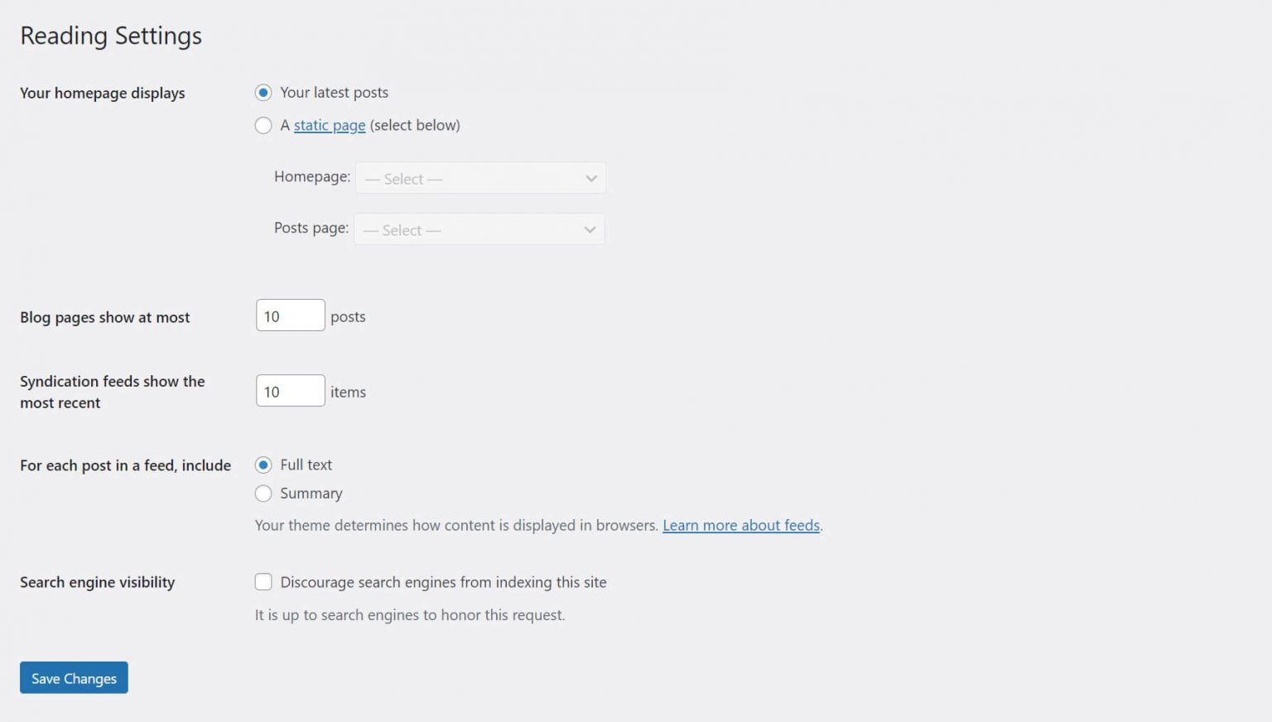
WordPress Reading Settings
The options on the Reading Settings page shape the experience for users who are visiting your site or interacting with your content via feeds:

Slide 98
WordPress Reading Settings continue
These settings perform a few key functions, such as telling WordPress which page is your site’s “home” – either your blog page or another page of your choosing. They also control the number of posts displayed on your blog page.
In addition, this screen offers a setting that instructs search engines whether or not to index your site. You can find all of these controls by heading to your WordPress dashboard and navigating to Settings > Reading.
How to Configure Your WordPress Reading Settings
Now that you know how to find these settings, it’s time to examine them more closely. Let’s explore what each option on this page does, and how you can best use it to enhance your WordPress site. Remember to save any changes you make to this page.

Slide 99
WordPress Reading Settings continue
Homepage Settings
The first section of the reading settings determines the content that’s displayed on your site’s homepage. There are two options:
Your latest posts
A static page
If you select Your latest posts, your front page will simply be a chronological list of your most recent blog posts. Users will see this page when they visit your site’s primary URL (i.e., “abu.edu.ng”).
On the other hand, you can select A static page to choose a specific page as your home:

Slide 100
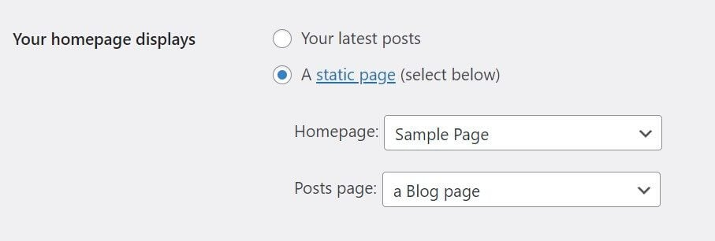
WordPress Reading Settings continue
If you pick this option, you can also specify which page will contain your blog posts, so you can add it to your site’s menu. In this case, we’ve selected “Sample Page” as our Homepage and “a Blog page” as our Posts page. The menus are simple drop-downs that list each page on your site. If you don’t have these pages ready just yet, you’ll need to create them first.

Slide 101
WordPress Reading Settings continue
The best option to choose really depends on your site’s goals. For example, if your blog is the main focus, displaying your most recent posts might make sense. However, if your blog is just a smaller part of a larger business site, you’ll probably want a static homepage. That way, you can introduce your company and products or services first.
Blog Page Setting
The next section of the WordPress reading settings determines how many blog posts the Content Management System (CMS) shows before requiring users to click over to a new page. The default is ten, and that’s usually a solid number to stick with. However, you can go lower if you display longer article excerpts or find that the page loads too slowly.
In fact, page speed is the primary consideration when deciding how to configure this setting. The more posts you showcase per page, the greater the impact on performance and loading time will be. Therefore, we don’t recommend going over the default of ten posts.

Slide 102
WordPress Reading Settings continue
Search Engine Visibility Setting
The final option on the WordPress Reading Settings screen is a simple checkbox: Discourage search engines from indexing this site.
This option does two things. First, it adds a line of code to every page on your site, which tells search engines not to index your pages. It also modifies your site’s robots.txt file, which is used as a reference by search engines. In this case, it will instruct search engines not to crawl or index any page on your site.
However, keep in mind that even with these two additions, it’s still up to the search engine crawler whether or not it honors the requests. This means your site might still be indexed regardless of your preferences.
Typically, we recommend leaving this option unchecked. Most sites want to be indexed by search engines, so they’ll appear in relevant results.
If your site is a private one intended for friends and family or is used internally at a company, this setting can help keep it away from prying eyes. You may also want to discourage search engines from indexing your website while it’s being built.

Slide 103
How to recreate permalinks on WordPress
Permalinks in WordPress are the permanent URLs to your individual posts, pages, and other content types on your website. They are the web addresses that people use to link to your content, and they play a crucial role in both SEO and user experience.
Types of Permalink Structures:
Plain: http://example.com/?p=123
Day and Name: http://example.com/2023/08/08/post-name/
Month and Name: http://example.com/2023/08/post-name/
Post Name: http://example.com/post-name/ (Most commonly used for SEO)
Custom Structure: Allows you to create a unique structure by combining different tags.

Slide 104
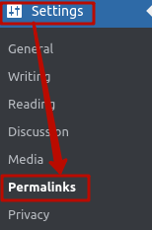
How to recreate permalinks on WordPress continue
Follow the steps below to change a permalink:
Log into your WordPress Admin area, go to the Settings menu, and click on Permalinks:
Take note of the type of permalinks that is currently in use for later reference.
Next, select any other option that is different from the current one. For example, if you were using Plain, select Post name. Click on Save changes to apply them:
To verify the result, refresh the website page by pressing Ctrl+F5 or open it using the incognito mode.

Slide 105
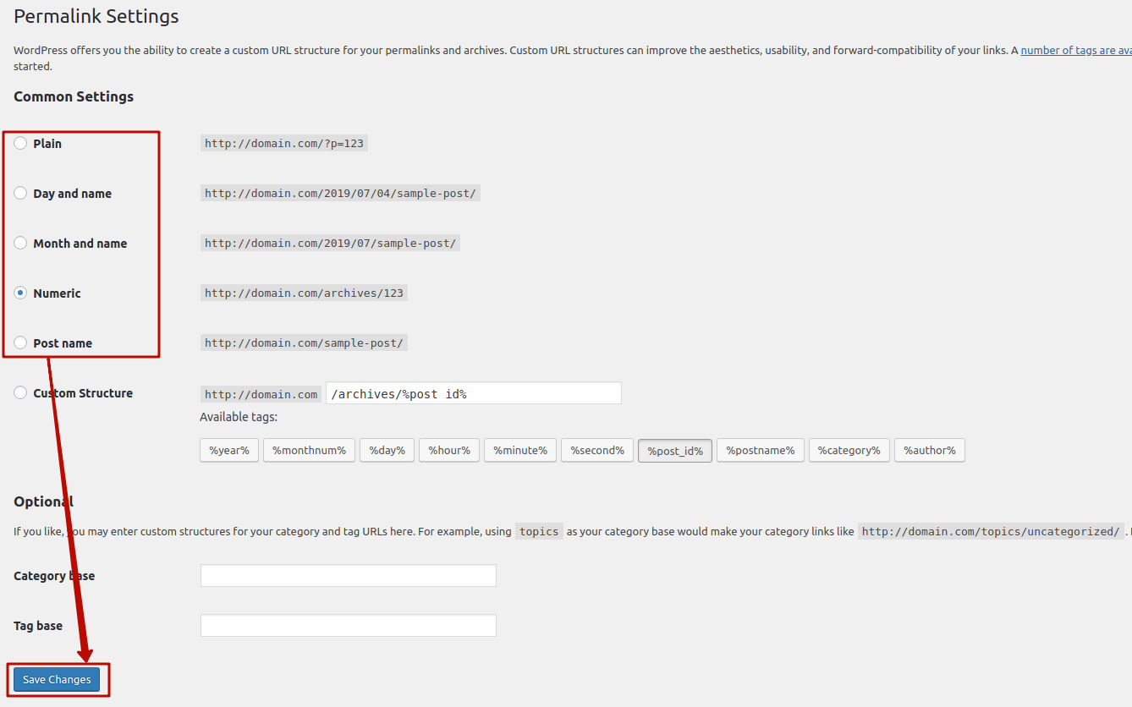
How to recreate permalinks on WordPress continue

Slide 106
How to Choose a WordPress Theme?
Here’s what to look out for when picking the right theme for your WordPress site:
Understand Your Needs. The first step in choosing an ideal WordPress theme is to decide on the website’s purpose, whether it is a simple blog, a digital portfolio, or an online store. Each of them will need different features and layouts. For example, a photography portfolio may need a gallery layout and animations to attract clients, while portfolio sites may be better with a minimalist, one-page WordPress theme.
Check the Customization Options. Sometimes, users may find a suitable theme for their brand but still want to customize it further to ensure that every page shows their personality. One way to check a theme’s customizability is to install the WordPress theme, head over to Appearance -> Themes on the WordPress dashboard, and click Live Preview.

Slide 107
How to Choose a WordPress Theme continue

Slide 108
How to Choose a WordPress Theme continue
After that, you should see the WordPress Theme Customizer dashboard and the theme’s customization features on the left sidebar

Slide 109
How to Choose a WordPress Theme continue
After that, you should see the WordPress Theme Customizer dashboard and the theme’s customization features on the left sidebar

Slide 110
How to Choose a WordPress Theme continue
3. Consider SEO. A WordPress theme can influence website performance, including stability and speed, which is vital for search engine optimization (SEO). Therefore, avoid picking a bloated theme that is cluttered with features and codes. A feature-rich theme may be attractive, but it can slow down a website. Look for “SEO ready” labels or similar in the theme description to ensure that the theme is SEO-friendly.
4. Prioritize the Responsiveness. Google considers mobile-friendliness a critical ranking factor as more than 90% of global users access the internet using mobile devices. Therefore, using a responsive theme is essential to make your site engaging and functional on any user’s device. Many WordPress theme developers say their themes are mobile-friendly, but we recommend double-checking the information. To do so, copy and paste a theme’s demo site URL to Google’s Mobile-Friendly Test. An alternative is to use Chrome’s Developer Tool. Simply right-click on the demo site, choose Inspect, and select a preferred screen dimension or adjust it manually using the handles.

Slide 111
How to Choose a WordPress Theme continue
5. Ensure the Plugin and Browser Compatibility. While themes help make a website visually appealing, plugins add functionality. Therefore, find a theme supporting plugins you need to avoid compatibility issues. Check the theme description and its official website, or contact the developer to know the details.
Depending on your website type, some popular and useful plugins include:
AIOSEO – an SEO plugin to add meta descriptions and keywords and audit the SEO performance for the entire site.
WooCommerce – a WordPress eCommerce plugin for an online business owner.
WPForms – a form builder to create contact, order, and survey forms.
Specific website types may also need other plugins. For instance, a food blogger will need a recipe plugin, and a travel blogger can attach a mapping plugin.
Next, see if the WordPress theme is compatible with different browsers. Open the theme’s demo site on several popular browsers like Microsoft Edge and Google Chrome to ensure it performs and appears well.

Slide 112
How to Choose a WordPress Theme continue
6. Calculate Your Budget. Having a premium theme is not a must since many free options are available. Both types of themes have pros and cons, so consider your needs and budget when deciding on one. A free theme might be suitable for users who are just starting. However, we recommend sticking to the official WordPress theme director for safety if you use free themes. It is also critical to check if the developers are active in the WordPress forum or provide documentation to help you figure out the theme’s customization options or troubleshoot problems. Meanwhile, an online store or a bigger organization can use a paid theme and take full advantage of its customization features and personalized support.
7. Keep Up to Date With Reviews and Releases. Once you decide on a theme, check the ratings and read the reviews before activating it. For a free theme in the WordPress directory, find the testimonials on the theme listing page and select See All in the Ratings section. Similarly, read user comments when you pick a premium theme. Generally, you can find them at the bottom of the theme page or sidebar on a theme marketplace.
The theme’s latest update date is also an important aspect to consider. Even if a theme is well-coded, it may be full of outdated code and contain security vulnerabilities if the last update was a few years ago.

Slide 113
What you need to do before installing a WordPress theme
Before installing a new WordPress theme, take these precautionary measures to protect your content and settings:
Back up the WordPress site. If anything goes wrong, you can restore your site to its previous state without losing any data.
Test the new theme on a staging website. As a copy of your live site, the staging environment lets you experiment without affecting user experience or functionality.
Save current code customizations and the tracking code. Doing this before changing themes simplifies the process of reapplying them to the new theme, ensuring your site’s functionality and analytics remain intact.
Update WordPress and plugins. Make sure you’re using their latest versions to avoid compatibility issues with the new theme.

Slide 114
Ways to install a WordPress theme
After completing all the necessary preparations, you’re ready to change your site’s theme. We’ll guide you through four installation methods, starting with the simplest. There are four (4) common ways of installing WordPress theme, which are:
Using the WordPress theme directory in the dashboard
Uploading a theme to WordPress
Adding a WordPress theme to the installation folder
Installing a WordPress theme using the WP-CLI
For the purpose of this course, we will focus on 1 and 2

Slide 115
Using the WordPress theme directory in the dashboard
This is the most easiest way to install themes on WordPress but you can only install free themes through this method so let's see how to do it. This method works for installing free themes in the official WordPress theme directory. Here’s how:
Log in to your WordPress admin page.
Head to Appearance → Themes from your WordPress dashboard, then select Add New Theme.

Slide 116
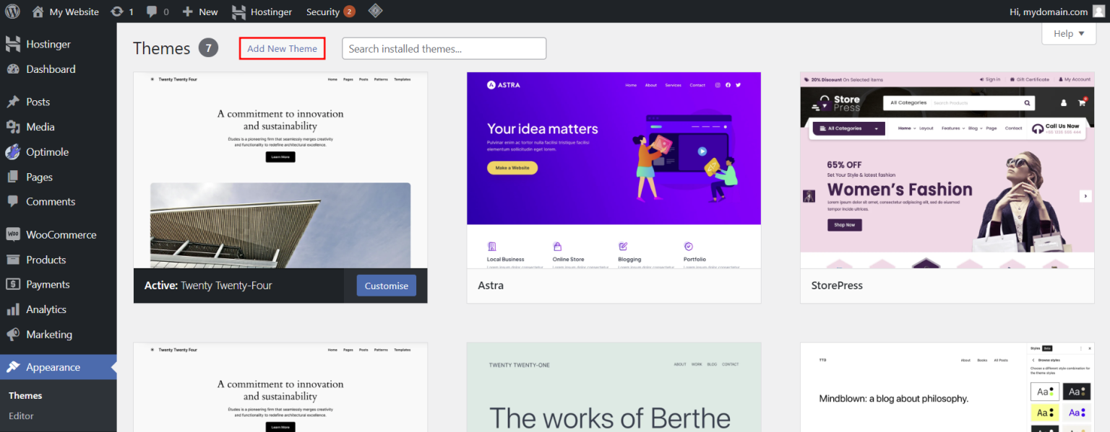
Using the WordPress theme directory in the dashboard continue

Slide 117
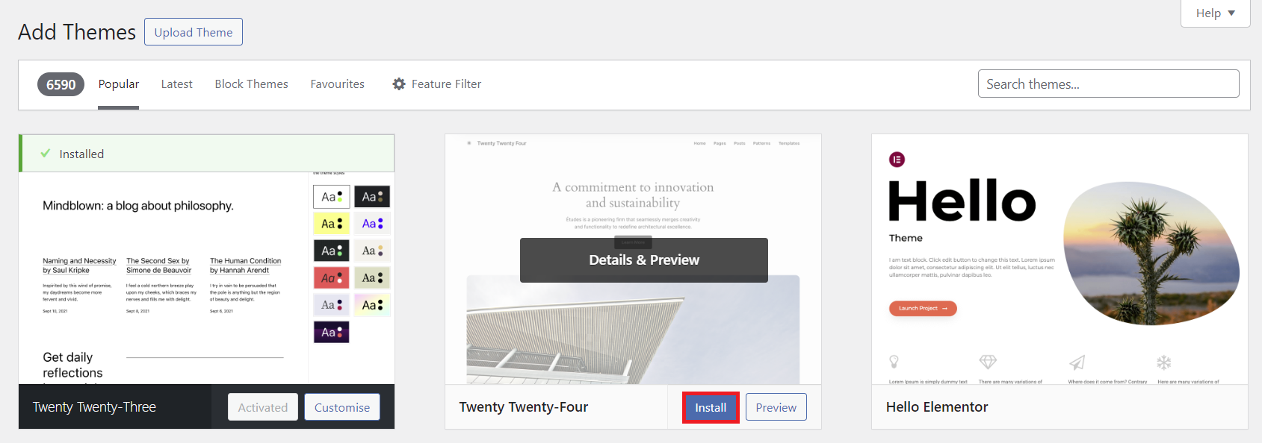
Using the WordPress theme directory in the dashboard continue
3. Use the filter function and search bar to narrow down your options. Hover over a theme and hit Preview to see its designs. Once you find your desired theme, click Install.

Slide 118
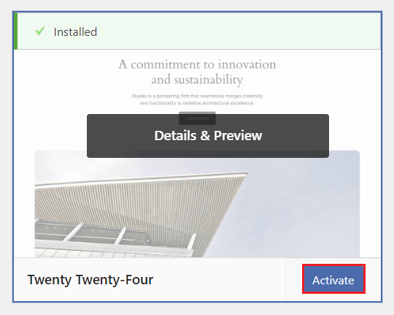
Using the WordPress theme directory in the dashboard continue
4. After the installation is complete, the Activate button will appear. Click on it to start using your new theme. Repeat this step to switch to another installed theme.

Slide 119
Uploading a theme to WordPress
If you want to use a WordPress theme from a third-party platform, you need to upload it to the website manually. This method also applies to premium themes that require you to download assets after purchasing.
The installation process is just as straightforward as the first method. Here’s how:
Go to Appearance → Themes → Add New Theme from the WordPress dashboard, then hit the Upload Theme button.

Slide 120
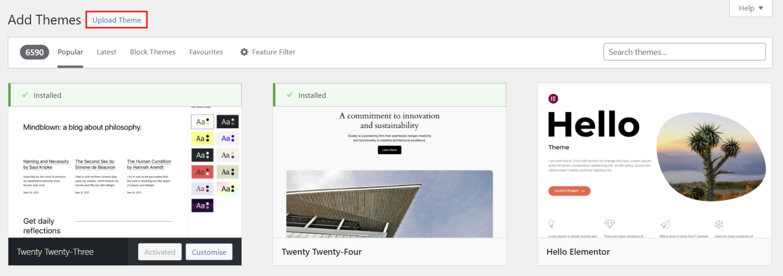
Uploading a theme to WordPress continue

Slide 121
Uploading a theme to WordPress continue
Upload the theme’s ZIP file you downloaded from the third-party platform and hit Install now.

Slide 122
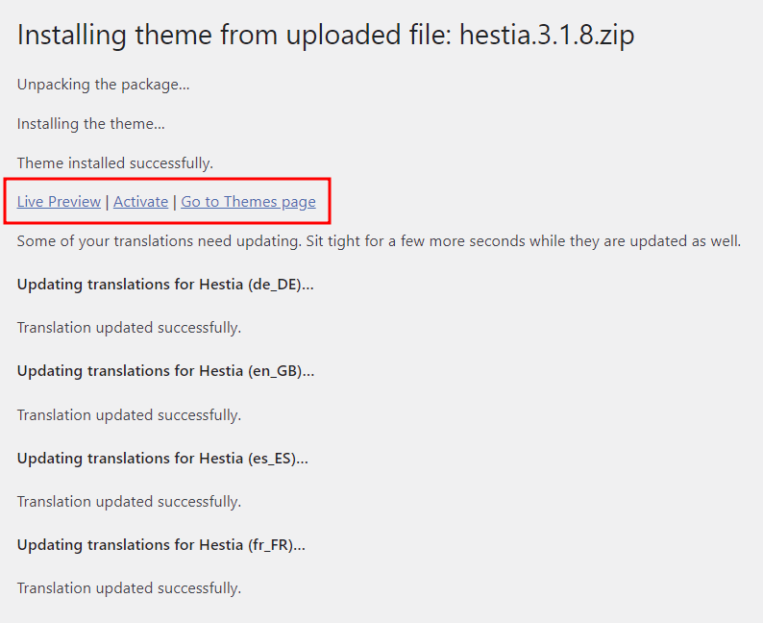
Uploading a theme to WordPress continue
After installing the theme, you’ll see the option to Preview or Activate it. Click the latter to start using the new theme.

Slide 123
Uploading a theme to WordPress continue
You may like to watch the video illustration for uploading a theme for all the ways by following the URL below:
https://youtu.be/-3bZwIEDmwA
Your WordPress theme decides how your website will look, so it’s essential to choose the right one and install it correctly.
Let’s recap the five ways to install your chosen theme:
Through the WordPress theme directory in the dashboard.
Uploading the theme’s ZIP file through the dashboard.
Adding it to the installation folder using a File Manager or FTP client.
Uploading the WordPress theme files using WP-CLI.

Slide 124
WordPress Media Library
Images, videos, and other media files can make a website more user-friendly, breaking up the rows of text with some much-needed color. However, not all new WordPress users know how to add new media files to their WordPress blog, what WordPress Media Library is, or how it is related to their website.
If that is the case with you, don’t worry – this article will explain all you need to know about WordPress Media Library, how it works, and how to upload and download files from it. We’ll also recommend six plugins for organizing your library.
What Is WordPress Media Library?
WordPress Media Library is a directory that catalogs all media files uploaded to your site in one place.
You can access WordPress Media Library by clicking Media on the WordPress admin dashboard.

Slide 125
WordPress Media Library Continue

Slide 126
WordPress Media Library Continue
Upon accessing the Media Library page, you will see some options to browse files easily.
First, choose how you want to view the media items in your library. Click on the list icon to activate the media library list view.

Slide 127
WordPress Media Library Continue
Another option is to view the media files in grid view by clicking on the grid icon.

Slide 128
WordPress Media Library Continue
There is a drop-down menu to filter the media files by media type to the list and grid icons’ right. It shows all media items by default.

Slide 129
WordPress Media Library Continue
Next to the media item filter, there is another drop-down menu to filter the media files by their upload dates. The default settings show the media items from All dates.

Slide 130
WordPress Media Library Continue
Next to the media item filter, there is another drop-down menu to filter the media files by their upload dates. The default settings show the media items from All dates.

Slide 131
WordPress Media Library Continue
If you know the name of a specific media file you are looking for, simply type the name into the search bar on the screen’s right side.

Slide 132
WordPress Media Library Continue
When using the grid view, the Bulk select button lets you select multiple media files and delete them at once.

Slide 133
WordPress Media Library Continue
WordPress supports the following formats of media types:
Audio files, ending .m4a, .mp3, .ogg, and .wav.
Image file formats, ending .gif, .ico, .jpeg, .jpg, and .png.
Videos, ending .3g2, .3gp, .avi, .m4v, .mov, .mp4, .mpg, .ogv, and .wmv.
Word documents, ending .doc and .docx.
Excel spreadsheets, ending .xls or .xlsx.
Powerpoint presentations, ending .pps, .ppsx, .ppt, and .pptx.
Adobe Photoshop documents, ending .psd.
PDFs, ending .pdf.

Slide 134
How to Upload Media Files to WordPress
Let us walk you through several easy methods to upload new media files to your WordPress Media Library.
Upload Media Files via WordPress Admin Dashboard
To upload new media items through your WordPress dashboard, follow these steps:
Click Media on your WordPress admin sidebar menu.

Slide 135
How to Upload Media Files to WordPress continue
2. Click the Add New button at the top of the screen.

Slide 136
How to Upload Media Files to WordPress continue
Upload your files by dragging and dropping them into the box or click on the Select Files button. Make sure the file size doesn’t exceed the limit.

Slide 137
WordPress Image Upload Errors
Uploading files to the WordPress library doesn’t always go smoothly.
You may run into errors such as the HTTP error when uploading images, the Upload: Failed to Write File to Disk error, or your WordPress Media Library failing to load.
There’s no need to worry, however, as you can solve these problems easily:
For the HTTP error, wait for a few minutes before re-uploading your media file. If the problem is not fixed, your WordPress session may have expired. Log out and log back into WordPress.
For Upload: Failed to Write File to Disk error, make sure permissions are correct. The file permissions are adjustable via an FTP client, the control panel provided by your web hosting provider, or SSH.
When WordPress Media Library fails to load, it usually means there is a problem with your plugins or theme. Switch to a default WordPress theme, deactivate all of your plugins, and see if the problem persists. If WordPress Media Library loads properly afterward, don’t forget to fix the problem with your plugins or theme permanently. Try contacting the plugin or theme developer for more information.

Slide 138
How to Download Media Files From WordPress Media Library
To download media files from the WordPress library, follow the steps below:
On your WordPress admin dashboard, click Tools on the navigation menu and select Export from the tools list.

Slide 139
How to Download Media Files From WordPress Media Library continue
Select the Media radio button. Next, choose the start and end date to download the media files you uploaded during that specific time frame. Finally, click the Download Export File button.

Slide 140
How To Edit Images on WordPress
WordPress has some useful built-in image-editing tools.
However, keep in mind that these tools are quite limited compared to graphic design software, such as Adobe Photoshop.
To find the image editor, simply select the file you want on WordPress Media Library. The Attachment details window will pop up. Click the Edit Image button under the media file.
The WordPress image editor has several tools. First, we’ll focus on the three tools found above the image – crop, scale, and rotate:

Slide 141
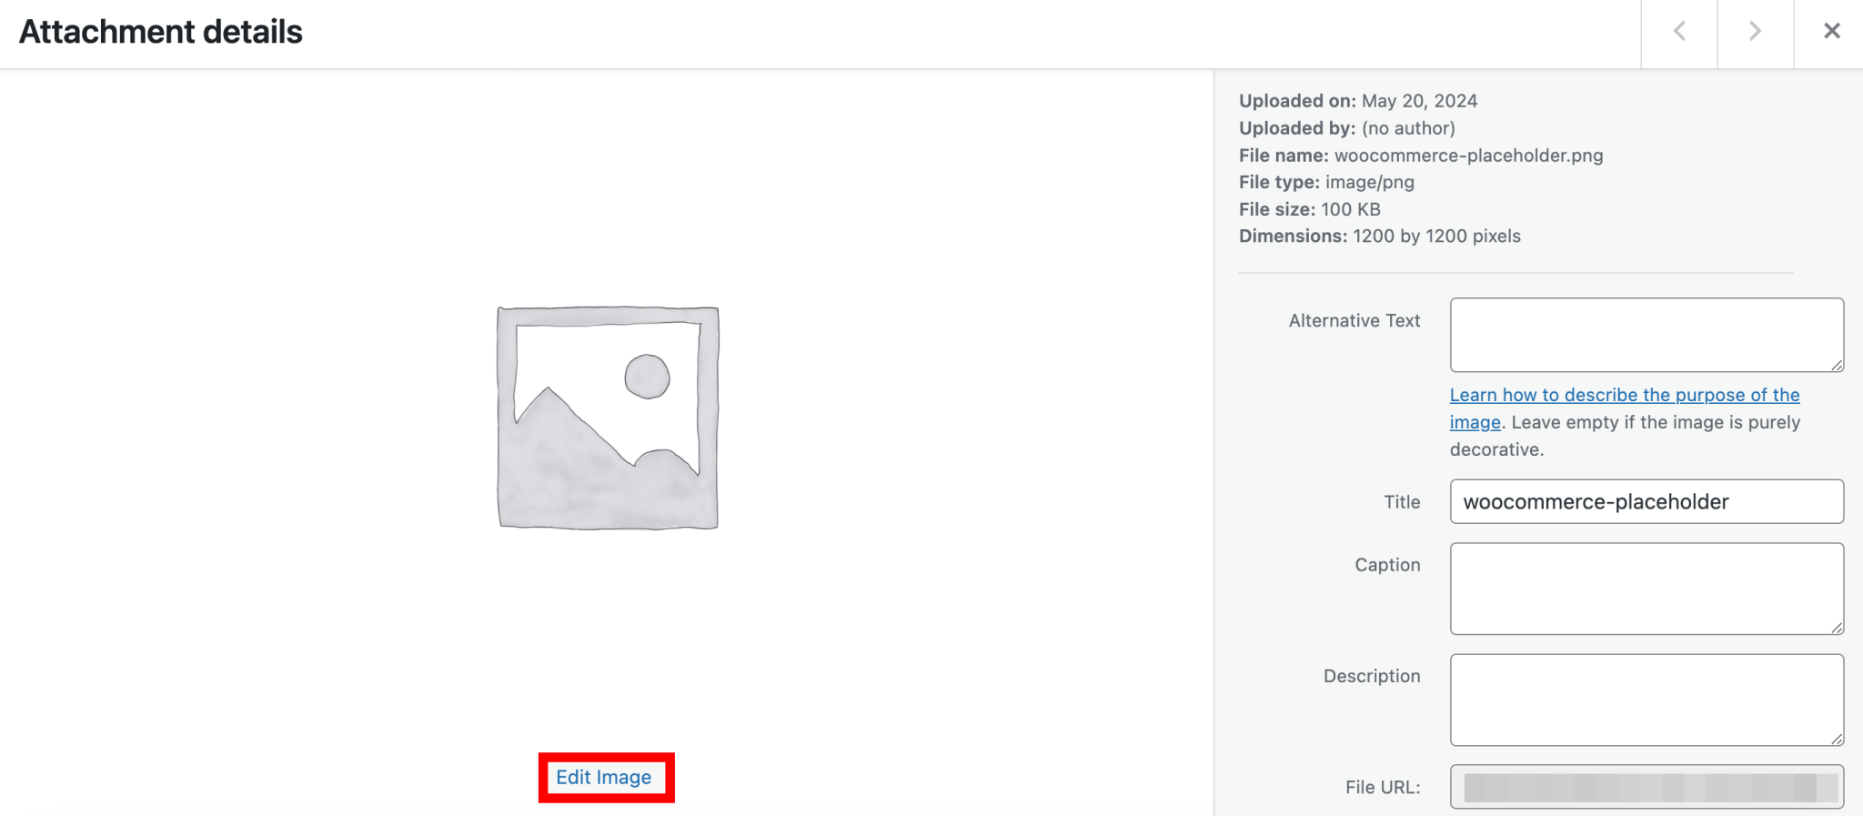
How To Edit Images on WordPress continue

Slide 142
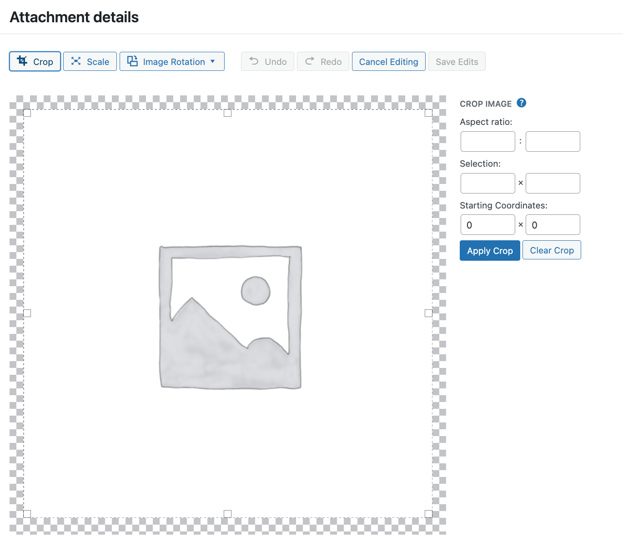
How To Edit Images on WordPress continue
The Crop tool cuts images. To crop an image, click the Crop button. Adjust the cropping frame to the size you want, then click the Apply Crop button.

Slide 143
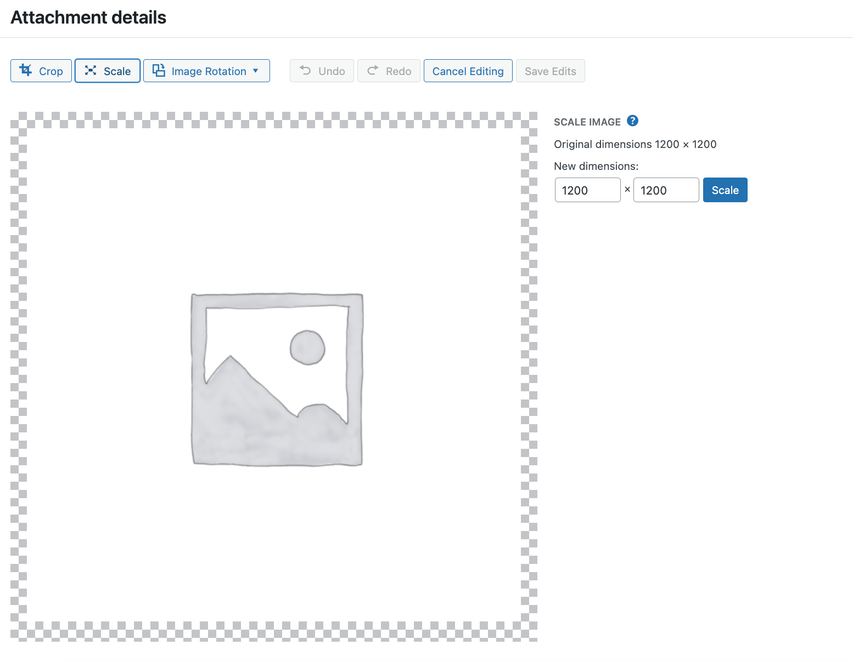
How To Edit Images on WordPress continue
The Scale button lets you change the dimensions of your image. Clicking on the Scale button at the top lets you change the image dimensions in pixels. Modify either the height or width and the other field will adjust accordingly. Keep in mind that images can only be scaled down.

Slide 144
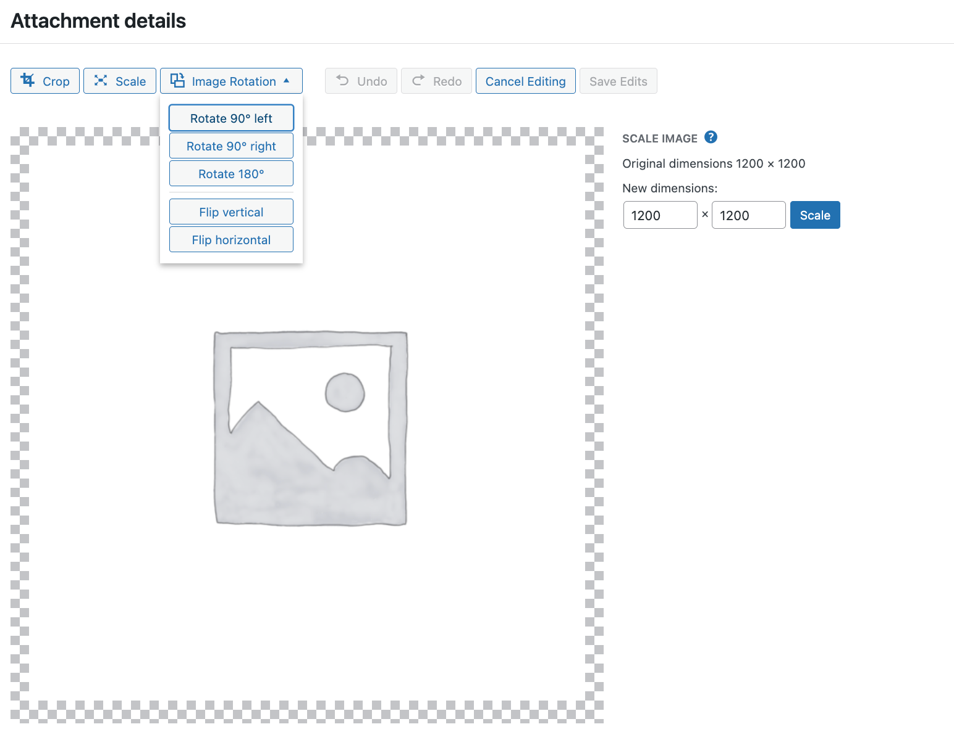
How To Edit Images on WordPress continue
The Image Rotation tool lets you rotate and flip the image. Clicking on the Image Rotation button will provide you with the options to rotate it to the left, to the right, upside down or flip it.

Slide 145
How To Upload Media Content
You may follow the video links below for further guide:
https://www.youtube.com/watch?v=VLptzjeoXGw
https://www.youtube.com/watch?v=rz3p8kBVOK0
https://www.youtube.com/watch?v=HbbkJ-oZu34
https://www.youtube.com/watch?v=kqc18e2KPpw

Slide 146
WordPress Plugin
WordPress plugins are a crucial aspect of building WordPress websites as they allow users to add additional features without touching a single line of code. Plugins help make WordPress the easy-to-use, flexible, and feature-rich content management system it’s known today.
Having a basic knowledge of plugins is essential for every WordPress user, and we’re here to help. You’ll learn what WordPress plugins are, how to use them, and what types of plugins are out there.
As one of the most popular content management systems (CMS), WordPress offers high flexibility and numerous customization options. It offers a wide variety of WordPress plugins, which allow you to tweak your website’s functionality.
WordPress has its own plugin directory, which includes free and premium plugins. These plugins let you add various features, ranging from contact forms and custom newsletters to website caching and WordPress security.

Slide 147
WordPress Plugin continue
Some plugins can also alter your WordPress site to make it a functional online store with a WooCommerce plugin or an eLearning platform with LMS plugins. In fact, you can even create your own WordPress plugin.
In this section, we will show the step-by-step process of installing WordPress plugins using three different methods. At the end of this article, we will also include a few tips you can follow when looking for new WordPress plugins to improve your site.
What Is a WordPress Plugin?
A WordPress plugin is a software that integrates with your WordPress site to enhance or add new features, enabling the creation of diverse websites such as online stores, portfolios, and directories.

Slide 148
WordPress Plugin continue
Think of the WordPress core software as a brand-new smartphone with factory settings. It’s usable, but most users install additional apps to enhance the day-to-day use of their device and overall functionality. These apps are free to download, install, and uninstall whenever you like.
WordPress plugins work similarly. Over 58,000 plugins are available to download from the WordPress plugin directory. Whatever your site’s needs are, there’s most likely a plugin to achieve them.
While there are many free WordPress plugins available, you can also get premium or paid options. Free plugins offer basic functionality, while the paid options offer extra value like advanced features and dedicated support from developers.

Slide 149
How to Add WordPress Plugins to Your Website?
There are various ways to install a WordPress plugin, depending on where you got it from.
The first is the automatic method, which allows you to install plugins right from the WordPress admin area. The plugin directory is built into every WordPress core software for instant access.
From your admin screen, go to Plugins → Add New after you have logged in. You’ll find a gallery of plugins that you can install on your WordPress site. Use the search bar to find a specific plugin easily.
After you find the one you want to install, select the Install Now button. For example, we will show you how to install Akismet, an anti-spam WordPress plugin with more than 5 million active installations.
Once the installation is complete, click Activate to turn on your new WordPress plugin.

Slide 150
How to Add WordPress Plugins to Your Website continue

Slide 151
How to Add WordPress Plugins to Your Website continue
You can also manually install WordPress plugins that you’ve downloaded from other third-party sources. WordPress allows you to upload, install, and activate plugins in ZIP format.
This method allows you to install a plugin that may not be in the official WordPress directory but available from third-party directories instead, such as CodeCanyon and Codester.
However, be careful as many cyber attackers take advantage of plugins as a way to attach malicious code to websites. Before you install WordPress plugins, always make sure that the plugin source is trustworthy.
Before starting the plugin installation process, you need to first download the plugin ZIP file from your chosen source.

Slide 152
How to Add WordPress Plugins to Your Website continue
Next, access your WordPress admin area and click Plugins -> Add New. Then, locate the Upload Plugin button at the top-left side of the page.

Slide 153
How to Add WordPress Plugins to Your Website continue
Select the plugin ZIP file from your computer that you want to upload, then click Install Now.

Slide 154
How to Add WordPress Plugins to Your Website continue
Wait for the plugin installation to finish and press Activate Plugin.

Slide 155
What to Remember When Selecting a Plugin
There are many plugins in the WordPress plugin directory and even more available from third-party websites. This number of options can feel overwhelming, especially for beginners trying to figure out what’s suitable for their site.
The following sections will show you some essential things to consider when selecting a plugin for your website.
Regular Updates.
WordPress releases regular updates to keep its system up-to-date. That’s how they enhance performance, maintain security, fix bug issues, and add new features.
So before you install a plugin, consider these points:
Last updated. Choosing a WordPress plugin that is frequently updated can prevent you from security breaches. This also shows that the developers are still actively managing and improving the plugin.

Slide 156
What to Remember When Selecting a Plugin continue
Installation numbers. This number shows how popular said WordPress plugin is. As a rule of thumb, the higher the number of active installations a plugin has, the better quality it offers.
Ratings. Reviews and feedback from users can help you weigh in the pros and cons of a specific plugin. This gives you insight into how the plugin performs in real-time situations.
Compatibility. A plugin that receives regular updates from its developers is usually compatible with the latest version of WordPress. Always check the description tab to see which version of WordPress is required to run the plugin.
Making Sure It Is Right for the Job
Before you download and install a plugin to your WordPress website, be sure to check the claims made by the developers. Read through the plugin documentation, check the plugin’s support forums and read the reviews.
Researching through blog posts is also a good practice as many websites provide plugin reviews.

Slide 157
Install One Plugin at a Time
When testing out a plugin in WordPress, remember to install and test each plugin individually. This way, you will quickly see if it causes any problems to your site and if you can fix them.
If you decide to test several different plugins on WordPress, remember to deactivate the previous plugin before trying another.
Moreover, when you have several inactive plugins, it is best to delete them as too many downloads, and installations can overload your WordPress website and impact its performance.

Slide 158
Use Only One Plugin for Each Function
Although WordPress plugins are add new features and enhance your website functionality, installing too many of them can slow your site down.
This is because whenever you install plugins in WordPress, you’re adding new code to your website. When used excessively, the plugins will send too many HTTP requests to load their assets, such as CSS stylesheets, JavaScript files, and images, slowing down your website’s loading speed.
In addition, installing WordPress plugins that perform similar functionality can cause conflicts, risking one or both plugins to break. Thus, the best practice is to install one WordPress plugin for each functionality.
For example, both Yoast SEO and AIOSEO have similar sets of features – you only need to choose one to prevent plugin conflict.

Slide 159
How to Update a WordPress Plugin
It’s essential to keep your WordPress site up to date. This includes updating to the latest version of WordPress as well as refreshing your themes and plugins.
Updating WordPress plugins isn’t just about getting to add new features. It’s also one of the primary ways to maintain your website’s security. Previous versions of a WordPress plugin may have vulnerabilities that are addressed and fixed in later versions.
WordPress gives its users extensive flexibility when it comes to updating plugins. Users can decide which plugins should update automatically.
On your WordPress admin area, go to Plugins → Installed Plugins. You will see a table detailing the plugins you’ve installed on your site.

Slide 160
How to Update a WordPress Plugin continue
To manually update an individual plugin, select Update Now in the yellow notification box.

Slide 161
How to Update a WordPress Plugin continue
To manually update multiple plugins, select the plugins you want to update by checking their respective checkboxes. Then, select Update from the Bulk actions drop-down menu and click Apply.

Slide 162
How to Update a WordPress Plugin continue
To toggle automatic updates, click Enable auto-updates under the Automatic Updates column for each plugin.

Slide 163
How to Update a WordPress Plugin continue
Setting all plugins to update automatically will save you the hassle of checking and updating plugins regularly on your own time.
However, there are cases where you might prefer manual updates. While security updates should be installed immediately, feature updates aren’t as crucial. Sometimes, plugins that recently added a new functionality can be buggy or even slow down your site.
If you want to be extra careful, only toggle automatic updates for plugin developers that you fully trust. This means that you have to be diligent about checking the updates for your other plugins.

Slide 164
How to Remove or Deactivate WordPress Plugins
There will be times when you want to uninstall a plugin or two – some free WordPress plugins might not be updated regularly, giving your site security risks, for example. Others might slow down your site, or you simply don’t think they’re needed on your site anymore.
There are two ways you can remove WordPress plugins – automatically and manually.
The automatic method uses the settings that are available in the WordPress admin area.
Under the admin screens menu, navigate to Plugins → Installed Plugins.
In the table of plugins, find the one that you want to deactivate or remove.
Select Deactivate. This action only turns off the plugin and won’t delete it from your site. Skip the next step if you only want to disable the plugin temporarily.

Slide 165
How to Remove or Deactivate WordPress Plugins continue

Slide 166
How to Remove or Deactivate WordPress Plugins continue
Select Delete to remove the plugin from your site altogether

Slide 167
Links for Video Guides on Plugin
Installing a plugin:
https://www.youtube.com/watch?v=YRpeN03RCOI
https://www.youtube.com/watch?v=htKORokq7BI
https://www.youtube.com/watch?v=Sw2DAStN3G0
Removing and deleting Plugins
https://www.youtube.com/watch?v=99sEIgADXGE
https://www.youtube.com/watch?v=o_zrnk1uE2s

Slide 168
How Do WordPress Plugins Affect the Website Performance
Using WordPress plugins does put an additional strain on your web hosting resources to some degree. Thus, many people assume that installing too many plugins will cause their site to slow down.
However, in reality, a WordPress plugin’s quality and efficiency have a larger impact on site performance than the number of plugins you install.
High-quality plugins are designed efficiently as they take up minimal resources. In contrast, low-quality plugins tend to take up resources they don’t need, which can negatively impact site performance.
You can install dozens of high-quality plugins and have no issues. On the other hand, you can install one or two low-quality plugins and see your load speeds dramatically drop. In order to maintain good site performance, use plugins that are proven to work efficiently.

Slide 169
How Do WordPress Plugins Affect the Website Performance continue
A good rule of thumb is to check your website speed every time you install a new WordPress plugin. Use a tool like PageSpeed to determine if there’s any difference in site performance before and after you install plugins.
Note that poor site performance can result from other issues that have nothing to do with plugins.
Take the web hosting that you use, for example. There is a chance that your provider doesn’t practice good optimization practices, or you’re on an entry-level hosting plan with limited specifications.
Another common culprit is a bloated theme. Themes that offer too many features and have unoptimized code can often slow down a website. When picking a theme, it’s always a good idea to pick one that’s relatively lightweight.

Slide 170
What Types of WordPress Plugins Are There?
Now that you know what WordPress plugins are and how they work, it’s time to learn what types of plugins are available. Let’s overview some of the plugins categories, what some of the best WordPress plugins are and find out how each can be beneficial for your site.
Security. Other than having secure WordPress hosting, website-level protection is equally important. Insecure websites are vulnerable to data theft, malware, and monetary loss. WordPress website attacks are so common that Wordfence, a popular security plugin, reported 4.3 billion attempted attacks in 2020 alone. WordPress security plugins are designed to block these incoming attacks. Many of them are packed with features like active monitoring, firewalls, and malicious IP blacklisting.
Website Optimization. According to Pingdom, 34% of visitors leave websites that take longer than three seconds to load. This is why it’s essential to keep your website well-optimized. Website optimization plugins are made to clean up your site’s code and database, which will improve the performance substantially.

Slide 171
What Types of WordPress Plugins Are There? Continue
Contact Forms Plugins. A contact form allows your visitors to contact you quickly and easily without having to scour the website for your email address or other communication channels. Creating a contact form on your WordPress site can significantly improve visitors’ experience. If your selected theme does not offer such a form, there are tons of contact form plugins available for WordPress sites. Their features cover various customization and management options that will allow you to take full control of your forms.
Caching Plugins. Caching plugins create static copies of web pages that are shown to visitors. This process reduces the amount of data transferred between the browser, the WordPress database, and the server, significantly improving a site’s speed. Many website optimization plugins include caching functions, but some plugins are dedicated to caching only.
Booking Plugins. Booking plugins offer handy functionality for specific types of online businesses. It allows your visitors to make an appointment with you or book your services instantly. Online businesses that might benefit from booking plugins or a relevant theme range from rental services, restaurants, ticketing services, professional practices, and freelance creatives.Online businesses that might benefit from booking plugins or a relevant theme range from rental services, restaurants, ticketing services, professional practices, and freelance creatives.

Slide 172
What Types of WordPress Plugins Are There? Continue
Pop-up Plugins. Pop-ups are windows or forms that appear on websites. Pop-up plugins make it easy to add pop-ups to your web pages without any coding knowledge. They can be a great way to connect with your visitors and what they care about. They can also help you grow a mailing list, which is vital for building a following.
SEO Plugins. Search Engine Optimization (SEO) is the practice of refining a website and its content to rank higher on search results. SEO is essential to increase organic traffic to your site and make sales if you own an online business site. SEO can take years to master. Thankfully, an SEO plugin can help you apply its best practices. For example, an SEO plugin that focuses on blog content can analyze and give suggestions straight from your post editor.
There are other lots of plugins, these are just few examples

Slide 173
Where Can I Get WordPress Plugins?
It’s recommended that you get both premium and free plugins from trusted sources. Most trusted sources have security measures in place and quality control over the plugins they have in their library. Besides the WordPress plugin directory, here are some third-party sources that allow you to get both free and premium plugins with minimal risk involved:
WoredPress Official Website
CodeCanyon
PremiumWP
Envato Elements
Etc
However, be wary of third-party sources that offer pirated premium plugins that allow users to download paid plugins for free. While it might be tempting to get premium plugins without spending a dime, they’re not worth the risks.
Stealing from developers who put in hard work into plugin development is illegal. Plus, these types of free plugins often contain malicious content in their code that can steal private information or damage your website.

Slide 174
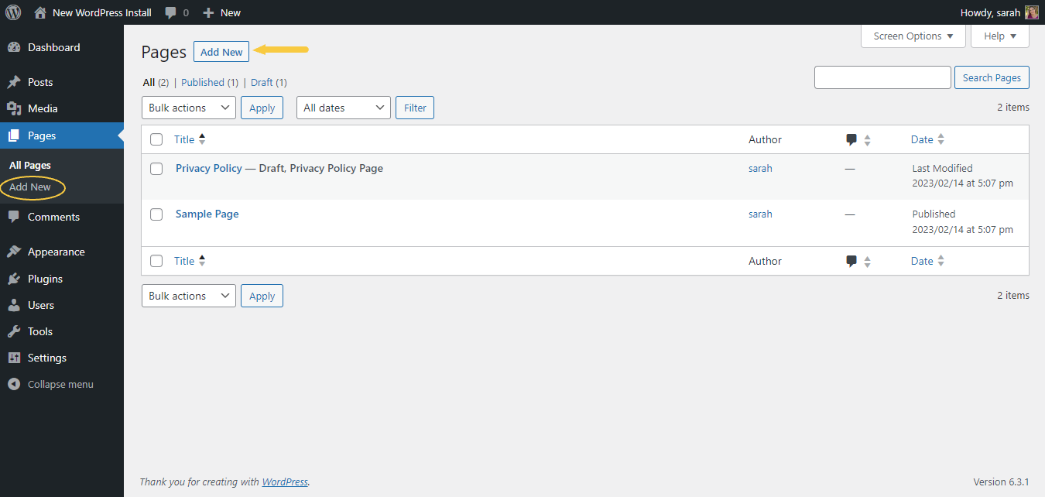
How to add pages in WordPress
To create a new page, first log in to your WordPress dashboard, then click on Pages located on the left. Continue by pressing the Add New button, typically located near the top of the page management section.

Slide 175
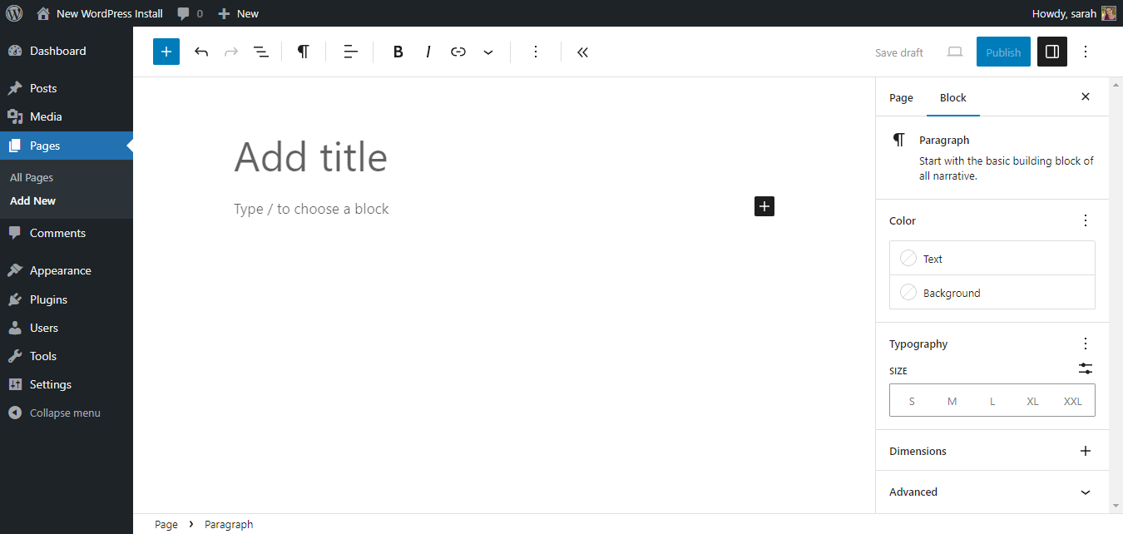
How to add pages in WordPress continue
In the WordPress editor, each paragraph, image, or video is presented as a distinct “block” of content.

Slide 176
How to add pages in WordPress continue
Each block comes with its own set of controls for changing things like color, width, and alignment. These will show and hide automatically when you have a block selected. All of the blocks available to you live in the Block Library. You’ll find it wherever you see the + icon.
Add Page Title
Next, add the title of the page, like About. The title of your page should be descriptive of the information the page will contain. Choose a helpful page title.
Note: If you have pretty permalinks set up, WordPress will use your page title as the permalink of your page. The permalink is the actual URL or web address of the page.

Slide 177
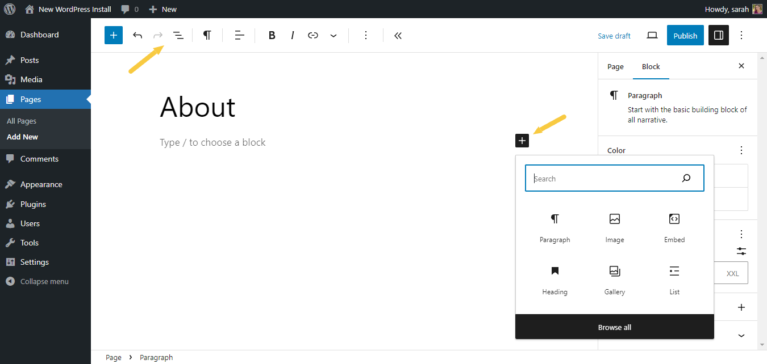
How to add pages in WordPress continue
Start Writing or Choose a Block
After you add your page title, it’s time to add some content. Content can be anything you choose … from text, headings, images, lists, videos, tables, and lots more.
To see the available blocks for your page, be sure the Top Toolbar is showing. Or, click button to add the appropriate block.

Slide 178
How to add pages in WordPress continue
WordPress Content Blocks
Blocks are the basis of all content within the WordPress page editor. Here are all the blocks you can use on your page.
Block Type | Description
Paragraph | The paragraph block allows you to easily craft content and is the default block type for text added to the editor. It is probably the block you will use most.
Image | The image block allows you to insert an image into your content from via upload, Media Library or from a URL.
Heading | Adds heading text (h2, h3, h4, h5, h5) to introduce new sections and organize content to help visitors (and search engines) understand the structure of your content.
Gallery | Display multiple images in a rich gallery.
List | Adds a bulleted or numbered list.
Quote | Give quoted text visual emphasis.
Audio | Embed a simple audio player.
Cover | Add an image or video with a text overlay — great for headers.
File | Add a link to a downloadable file.
Video | Embed a video from your media library or upload a new one.

Slide 179
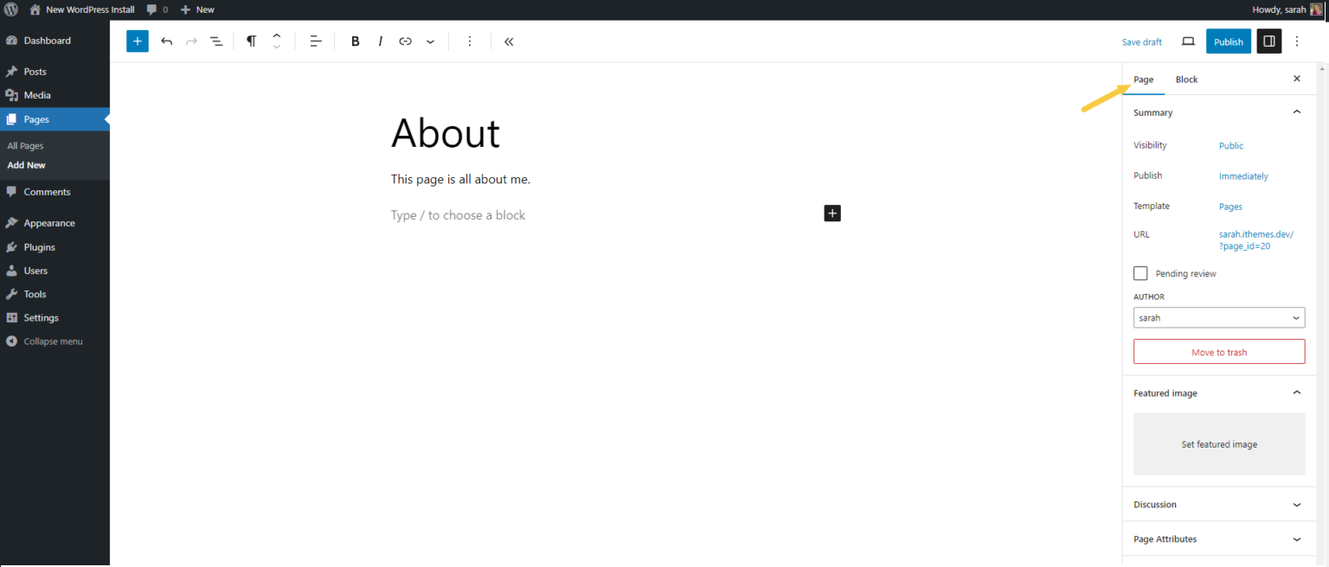
WordPress Page Settings
On the right side of the WordPress page editor, you’ll see Document settings for your page. This area contains some important settings for your page, so let’s go through them.

Slide 180
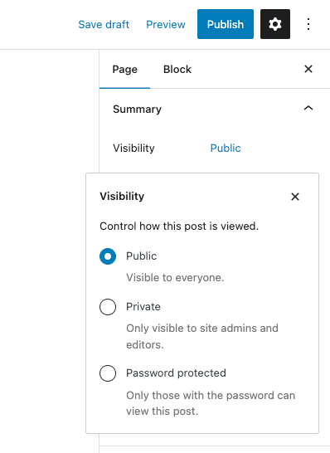
WordPress Page Settings continue
Satus and Visibility
The status and visibility section contains
details about how and if your page is viewable.
Visibility allows you to select between three options
Public – Visible to everyone
Private – Only visible to site admins and editors
Password-Protected – Make the page only viewable
with a password you choose. Only those with the
password can view this page.

Slide 181
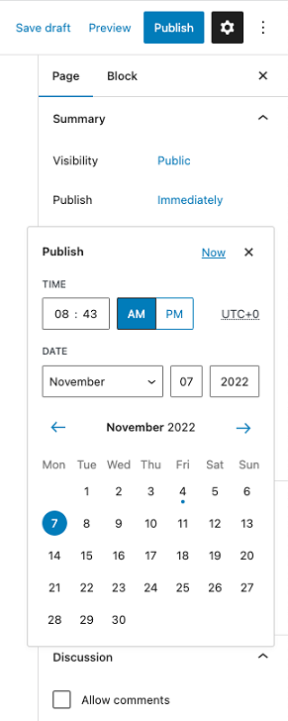
How to Schedule When Your WordPress Page Will Be Published
By default, any new page is set to be published right away.
However, you may wish to publish the page on a specific date.
The Publish setting allows you to either choose “Immediately”
or a date in the future for your page to be published. If you
want to schedule your page to be published in the future, click
on Immediately, which opens a calendar where you can select
the publishing date. Your WordPress website will then automatically
post the page at the scheduled time. You can use the time and
date picker to choose your preferred publication time.
If you want your page to publish immediately,
then leave this setting to Immediately.
This means when you hit the blue Publish button at the top of the
screen, your page will immediately go live.

Slide 182
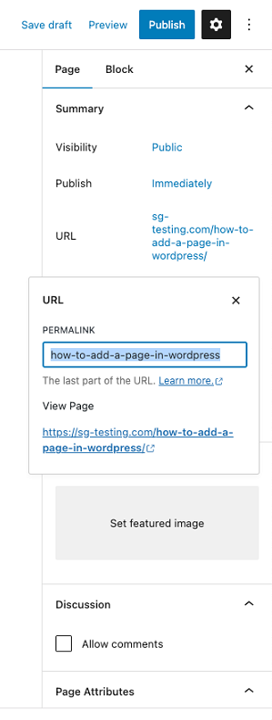
Other Page Settings
Permalink
Permalink is short for “permanent link.”
This is the field where you can customize the
last part of the URL of your new page.
For SEO reasons, it’s a good idea to choose a
slug that matches the title of your page rather than
a random string of numbers or characters. Be sure
to select pretty permalinks in your WordPress settings.
Each page has a unique URL, also called permalink
or slug. It is the address on which the page is visited
and distinguishes it from the other pages. The page’s
URL is created with a default name defined by the
website’s general permalink settings, but you can customize
the name from the section URL.

Slide 183
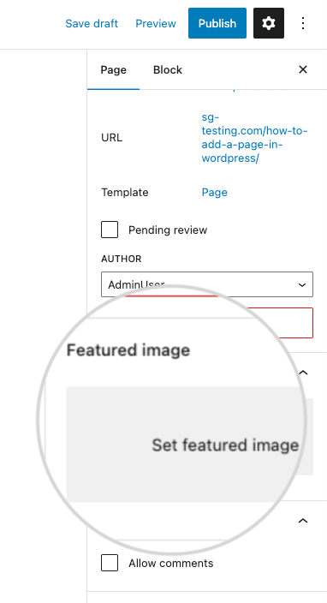
Other Page Settings continue
Featured Image
Depending on your theme, the featured image of your page may
be used in several ways (like on your home page, for example,
in a gallery-style listing of pages). Upload an image that “describes”
your new page here.Featured images are also used by social media
platforms like Facebook and Twitter as the preview image for the
page if you share a link to your new page.
Featured images are thumbnails that visually represent the page. For example, the featured image appears when you share the page’s link on social media.
You can choose it from the section Featured image, then simply
click on the field Set featured image. A new window will pop up
where you can select one of the images in your WordPress Media
gallery or upload an image from your computer.

Slide 184
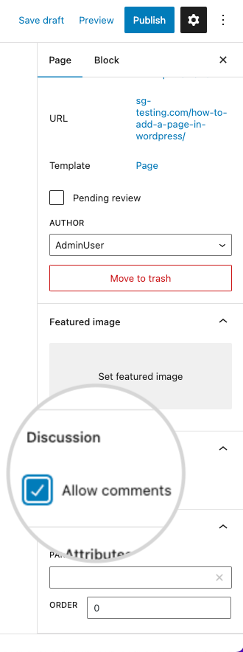
Other Page Settings continue
Discussion
Does the page allow comments (Discussion) ?
If you’d like to allow comments on your new page, you can
enable them here. Otherwise, leave this setting turned off.
Comments are a great way to engage your audience, as they can
lead to interesting discussions urging visitors to revisit the page
more than once. You can easily enable comments on the new page from the Discussion section by checking the box for Allow comments.

Slide 185
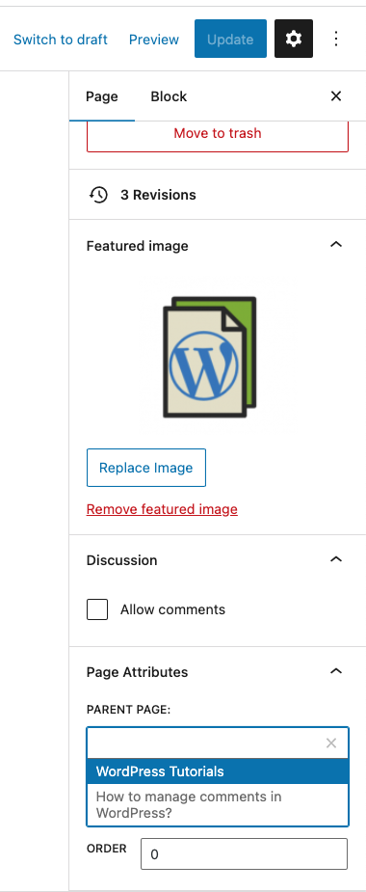
Page Attributes
The Page Attributes section applies a parent page and template
to your new page.
For the Parent section, you can arrange your pages into page
hierarchies. For example, you could create this new page with
additional pages under it. Or you could place your new page as a
child page beneath an existing page. Under the Parent page, click
on the drop-down menu showing all published pages on your website that you can set as a parent page to the new page.
Template – Some WordPress themes have custom page templates,
so the next Template section allows you to apply a template to your new page.
The Order box allows you to order your page numerically. Pages
are usually ordered alphabetically, but you can choose your own order by entering a number in this field.

Slide 186
How to preview a new page
Before publishing the page, you may want to preview how it appears live on your website. Regardless of the chosen editor, you can do that by using the Preview button in the top right corner. By clicking on it, the page loads, showing how the content appears for visitors

Slide 187
How to save a draft of a Page
The page is not finished yet, and you need to leave it for the moment, but you don’t want to lose the new edits. That is not a problem in WordPress since you can save the progress anytime. When you go back to editing the page, you will pick up from where you left off.
Simply click on the Save draft button, and WordPress will save your new changes.

Slide 188
How to delete a page
Your website will change over time, and eventually, a page might contain outdated information you no longer need. You can move the page to your WordPress trash bin. It will stay there for 30 days giving you the option to restore it should you reconsider. After 30 days the trash bin will delete the page permanently. You can delete the page from the Pages section in your WordPress dashboard. Hovering over a page will show the different actions you can perform on it. Delete the page by pressing on Trash.

Slide 189
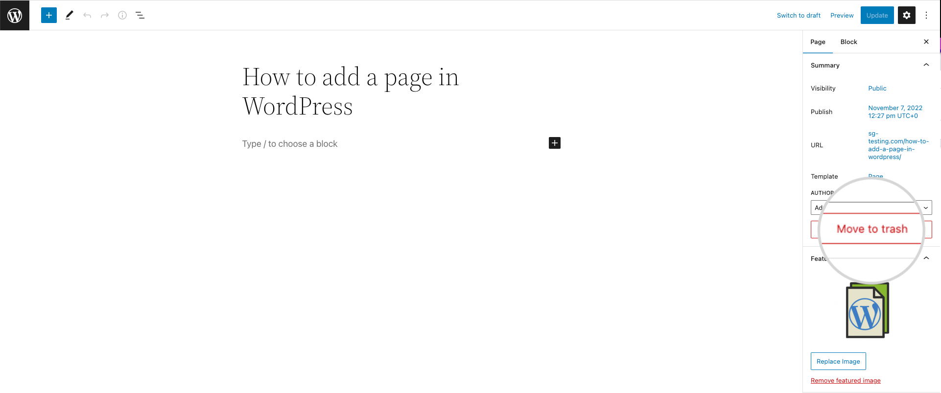
How to delete a page continue
Alternatively, you can delete the page from the page’s editor screen. From the Page settings section, click on the Move to trash button.

Slide 190
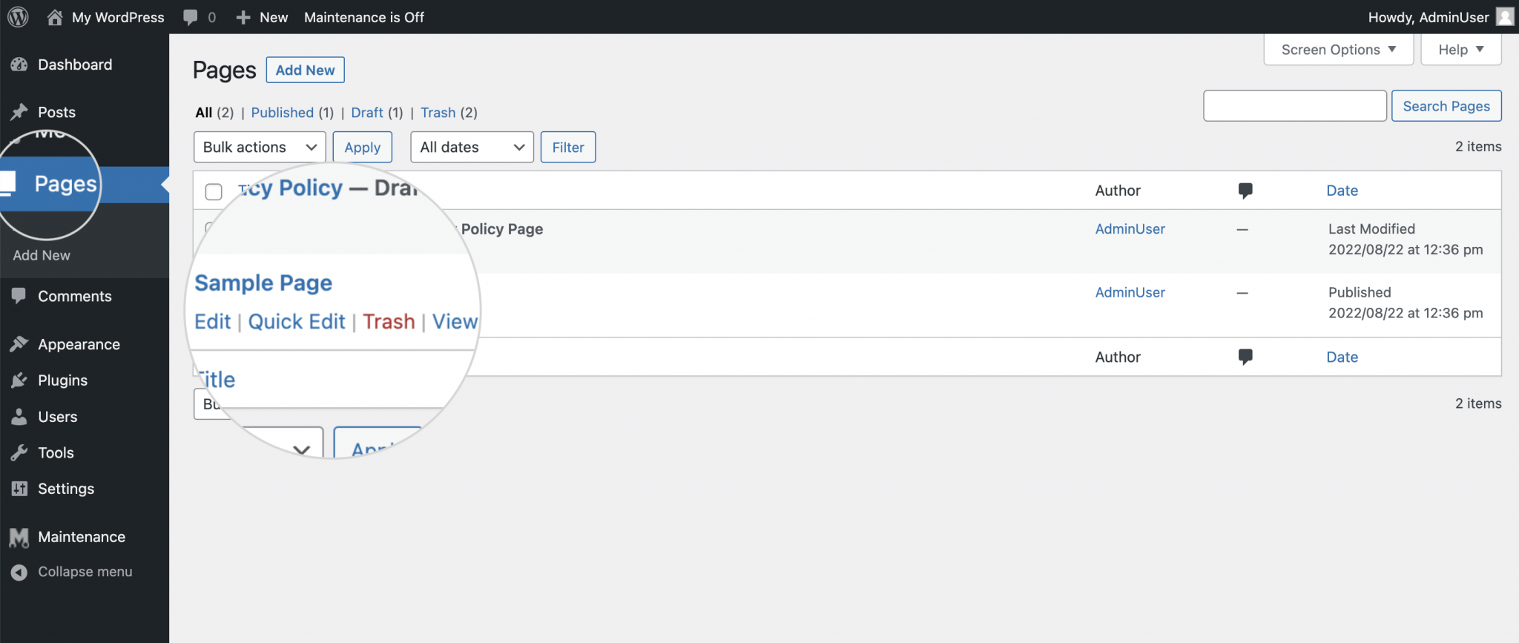
How to edit pages in WordPress
Hovering over one of the existing pages shows the actions you can perform on it.

Slide 191
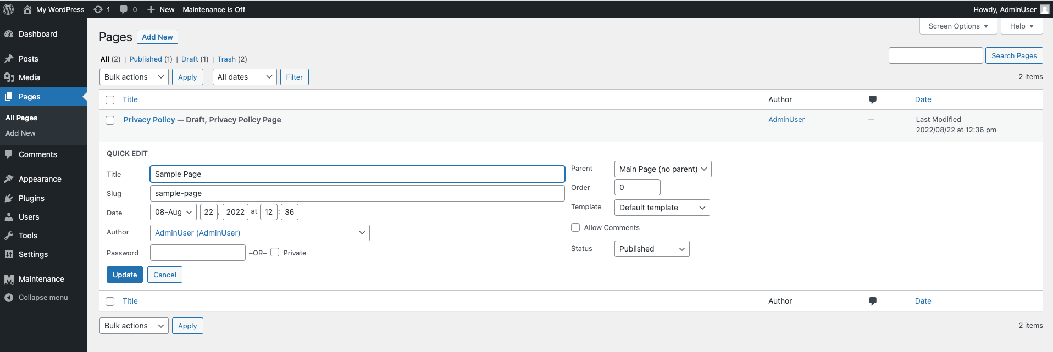
How to edit pages in WordPress continue
Edit – loads the page editor where you can modify the entire page – text, images, links, settings, etc.
Quick Edit – opens a quick editor on the same screen. In this mode, you can edit only the page’s general settings – title, slug, publishing date, etc.

Slide 192
How to Create a page continue
You may watch the video guides on how to create a page by visiting the URLs below:
https://www.youtube.com/watch?v=aPNjw-gQhwU
https://www.youtube.com/watch?v=tYP2zgD8Jw8
You may also watch how to create a landing page
https://www.youtube.com/watch?v=n0lu9ZOqNpk

Slide 193
How to Create a Post in WordPress
Whether you want to share thoughts, promote products, or provide information, learning how to create a post in WordPress is a fundamental skill for any website owner.
Starting a blog on WordPress and posting regularly keeps your site updated, provides valuable information for readers, and boosts search engine rankings.
This section will explain how to create a post in WordPress. We’ll also explore different tools, features, and options you can use. By reading this guide, you’ll expand your WordPress knowledge to create engaging and well-structured posts that resonate with your audience and elevate your site’s appeal.

Slide 194
How to Create a Post in WordPress continue
To create a blog post in WordPress, access your WordPress dashboard and navigate to Posts → Add New.

Slide 195
How to Create a Post in WordPress continue
This will lead you to the Gutenberg block editor or the classic editor, depending on your settings. This tutorial will demonstrate how to create a post on WordPress using the block editor.
Pro Tip
Remember, WordPress posts and pages have different functions. Posts are for regular content updates, whereas pages are typically static and updated less frequently.
Once on the editor, make sure to add the following elements before publishing the new post:
1. Add the Title and Content
The post title and content are essential parts of WordPress SEO. While it is possible to publish without titles, readers will need extra help finding the WordPress post, which can hurt your website’s user experience.
The title and content boxes will appear when you open the visual editor. You’ll automatically see an Add Title field at the top of the editor.

Slide 196
How to Create a Post in WordPress continue
Right below the title field is space to add any content type using blocks. If you’re starting with text, begin writing the blog post.
To add other blocks, click the + icon on the top left of the screen next to the WordPress logo.

Slide 197
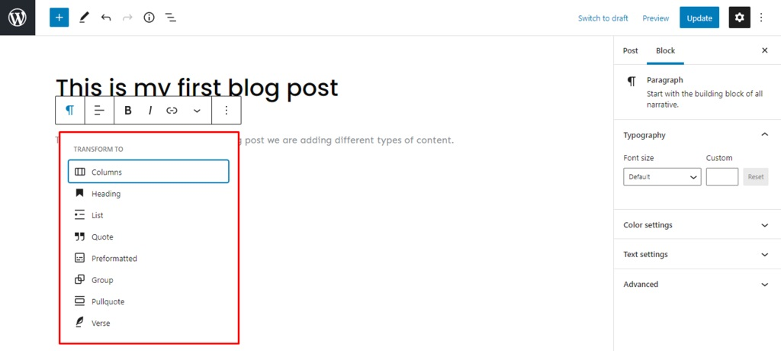
How to Create a Post in WordPress continue
There are blocks for all common content types, including a Paragraph, Column, and Heading. You can also add widgets, such as Latest Comments and Search. There are also blocks designed to embed third-party content.
You can also transform existing blocks. For instance, you can change a paragraph into a column, heading, or quote by clicking the block icon button.

Slide 198
How to Create a Post in WordPress continue
To make further edits, click the WordPress post Settings icon on the upper right corner of the screen. Then, select the Block section to view more editing options for all blocks.
If you find blocks too complicated, the Classic block lets you add content as you would using the classic editor. Then, it converts the content back to block form.
2. Add Images
It’s easier to capture visitors’ attention with images. Well-optimized WordPress images make your posts more appealing, increase site speed, and improve SEO.
There are two main image blocks – the Image block for uploading a single picture and the Gallery block for adding multiple images in a grid layout.

Slide 199
How to Create a Post in WordPress continue
There are three ways to upload images using the WordPress block editor:
Drag and drop the media directly into the chosen block.
Add existing media from the Media Library.
Upload a new image by going to the WordPress Dashboard → Media → Add New.

Slide 200
How to Create a Post in WordPress continue
To edit the image, click it and head to Settings → Block. You can change an image’s style, size, and dimensions there. Use the default WordPress image sizes or customize them to suit your website.
3. Add Other Media Files
Other media files can enhance the visual appeal of a WordPress post, including videos, audio, and downloadable documents.
To upload a media file, head to Dashboard → Media → Add New.

Slide 201
How to Create a Post in WordPress continue

Slide 202
How to Create a Post in WordPress continue
You can also add media directly in the block editor. Click on the + sign, and head to the Media section.

Slide 203
How to Create a Post in WordPress continue
You can also add media directly in the block editor. Click on the + sign, and head to the Media section.
Another way to add images, audio, and videos is by copy-pasting the file URL in the block. Since the media isn’t hosted on your server, it can help reduce the load on your hosting resources.

Slide 204
How to Create a Post in WordPress continue
4. Add a Featured Image
A featured image or post thumbnail is a picture that appears on search engines or social media when a WordPress post is shared. It helps attract visitors, increase content value, and improve SEO.
To add a featured image, open your post-editing screen. Head to Settings → Post → Featured image, and click the Set featured image link. It will direct you to the Media Library, where you can pick an image.
Choose the image wisely. It is the first thing your WordPress site visitors will see before opening the post content.
The image you select can be edited using tools on the right side of the Media Library. You can also change the alt text, caption, and image description.
Click the Replace Image button under the Settings section to change the featured image.
However, it’s possible your theme doesn’t support a featured image. In that case, follow this guide to fix the WordPress featured image not showing error.

Slide 205
How to Create a Post in WordPress continue

Slide 206
How to Create a Post in WordPress continue
5. Add Categories and Tags
Implementing WordPress post categories and tags is essential for SEO and website organization. It’s also excellent for user experience, as visitors can quickly locate other WordPress posts within the same category.
Categories cover the general topics of the blog. Meanwhile, WordPress tags are more specific to the individual post. For example, when writing blog posts for a food recipe, the tag would be similar to “pasta recipes,” and the category would be “recipes”.
Remember that you can assign multiple categories and tags to a post.

Slide 207
How to Create a Post in WordPress continue

Slide 208
How to Create a Post in WordPress continue
To add a new category or tag, go to Dashboard → Posts → Categories or Tags. From there, edit the name, post URL slug, and description. You can then view all the posts under the categories and tags.

Slide 209
How to Create a Post in WordPress continue
Furthermore, you can add categories to the website menu. Head to Dashboard → Appearance → Menus to find Categories under Add menu items. You can add posts, pages, categories, and URLs to your navigation here.

Slide 210
How to Create a Post in WordPress continue
6. Set Permalinks or Slugs
As an essential part of on-page SEO, permalinks or slugs help increase the post’s ranking on search engines.
Permalink stands for permanent link, the WordPress post URL generated from the post title. Meanwhile, the part of the URL that automatically follows the title is known as the post slug or URL slug. You can edit the post slug via Settings → Post → Permalinks.
Note that punctuations like commas, quotes, and apostrophes are invalid URL characters. They will automatically be replaced with dashes.
Fortunately, you can change a published post’s slug. If you changed a post title after publishing, recheck the slug.

Slide 211
How to Create a Post in WordPress continue

Slide 212
How to Create a Post in WordPress continue
7. Add an Excerpt
An excerpt is the summary or teaser of the blog post. It attracts and engages readers because the title and featured image sometimes need to be revised.
WordPress will automatically use the first 55 words of the blog content to generate the excerpt. However, you have the option to customize it by heading to Settings → Post → Excerpt and writing in the box. You may even customize the word limit using HTML code or plugins.

Slide 213
How to Create a Post in WordPress continue

Slide 214
How to Create a Post in WordPress continue
In WordPress, there’s an option to display the full content of your article and blog post or only to show the excerpt. To display excerpts for your blog posts, head to Dashboard → Settings → Reading. Then, for Each post in a feed, include section, select Summary.

Slide 215
How to Create a Post in WordPress continue
You can display more WordPress posts on the dedicated blog page by only showing excerpts. This can help generate more clicks.
8. Choose the Author
If your website has multiple contributors, assigning an author for each post is important for proper crediting. Although WordPress assigns the website’s creator as the default author, you can select different authors for each post.
To assign different authors, add more WordPress user roles first. Head to the Dashboard → Users → Add New. Fill out the username and email address, then change the role to Author.

Slide 216
How to Create a Post in WordPress continue

Slide 217
How to Create a Post in WordPress continue
To view all authors on your WordPress website, go to All Users. Make sure to check Role in the Screen Options tab. You will be able to see all of the users and the roles.
To change a post’s author, open the block editor and go to Settings → Post → Status & Visibility → Author.

Slide 218
WordPress Post Publishing Options
After learning how to create a new post in WordPress, let’s proceed to publishing.
Draft
WordPress has a handy autosave feature. However, we suggest saving manually by clicking the Save draft button on the top right corner. The Save draft option lets you save the progress for each post without publishing. To find all drafts, go to the Dashboard → Posts → All Posts → Drafts.
Once you have published the post, there is also an option to change the post back to a draft. To do this, go to the editor and click the Switch back to draft link on the top right corner of the screen.

Slide 219
WordPress Post Publishing Options continue

Slide 220
WordPress Post Publishing Options continue
Preview
The Preview button shows users how the post will appear on the website. This feature helps you check for any necessary adjustments before publishing. Depending on your WordPress theme, the content presentation can change drastically.
The Preview option can also adjust to different screen sizes. It shows a desktop preview by default, but you can also check how the post will look on tablet and mobile.

Slide 221
WordPress Post Publishing Options continue
Note that the Preview in new tab option only works for the desktop view.
To display the website preview on other screens, head to the Dashboard → Appearance → Customize. Change between the three different icons on the bottom left corner of the screen.
Nowadays, most people browse the internet using mobile devices and tablets. This option helps adjust the WordPress post to different screens.

Slide 222
WordPress Post Publishing Options continue
Status and Visibility
There are three options for post visibility:
Public – makes the post visible to anyone.
Private – private posts are only visible to authorized users logged in to the Dashboard.
Password Protected – create a unique password for your post and give access only to those who know it.
You can change the visibility type of a post that’s already published. To do this, head to Settings and click the link next to Visibility.

Slide 223
WordPress Post Publishing Options continue

Slide 224
WordPress Post Publishing Options continue
Scheduling
If you don’t want to publish immediately, the scheduling posts feature lets you set a specific time for the post to be published.
To schedule posts using WordPress, click the Settings icon and then the link next to Publish. It will display a calendar and an option to set the exact minute, hour, day, month, and year. If you have a global audience, check time zones before publishing.
You can schedule WordPress posts for a future or past date. This is useful when you want a post to appear as if it was published immediately on a different date.

Slide 225
WordPress Post Publishing Options continue

Slide 226
WordPress Post Publishing Options continue
Sticky Post
WordPress displays posts in reverse chronological order by default, with the most recent posts at the top. The sticky post feature lets you choose an article to always appear on top of other posts on the WordPress blog page.
Sticky posts are especially useful for featured content or those with an expiration date, like a giveaway competition for readers. Although WordPress doesn’t limit the number of sticky posts, we recommend using this option sparingly.
To pin a particular post, go to Settings → Status & Visibility and check the Stick to the top of the blog option. This will automatically put the article above other posts.

Slide 227
WordPress Post Publishing Options continue

Slide 228
WordPress Post Publishing Options continue
Another way to change the sticky post feature on an article is to go to Dashboard → Posts → All Posts. From there, click on Quick Edit under the article and tick the Make this post sticky option.

Slide 229
WordPress Post Publishing Options continue
Pending Review
This feature tells other back-end WordPress users that the article is finished and needs to be reviewed before publishing. WordPress adds the Pending status next to your article by checking this setting.
This is a useful feature for websites with multiple authors who need to inform one another about drafts that need to be reviewed. For single-author websites, the Pending status can act as a reminder to review a particular article before publishing.

Slide 230
WordPress Post Publishing Options continue

Slide 231
WordPress Post Publishing Options continue
Publish
Now that you know the options and processes, it’s time to publish the draft article. When you click the Publish button, it will show the visibility of the post, the publish date and time, and suggestions from WordPress.
If you don’t want to do pre-publish checks for your posts in WordPress, uncheck the box on the bottom right side of the screen.

Slide 232
WordPress Post Publishing Options continue

Slide 233
WordPress Post Publishing Options continue
Delete a Post
There are different ways to delete a post. The first option is to go to Settings → Move to trash in the editor.

Slide 234
WordPress Post Publishing Options continue
Another way is to go to Dashboard → Posts → All Posts, hover over a specific post, and click Trash.

Slide 235
WordPress Post Publishing Options continue
By default, the WordPress database saves deleted posts for 30 days before removing them permanently. If you change your mind, simply access the trash folder and click the Restore button on a deleted post.

Slide 236
Block Editor vs Classic Editor
The block editor and classic editor are tools for creating and editing posts and pages in WordPress.
The classic editor uses a formatting toolbar similar to Microsoft Word or Google Docs. It includes a visual editor for users who prefer to see what the content looks like visually and a code editor for people who like to edit using HTML code.
Meanwhile, the block editor is a simpler tool to write posts with its drag-and-drop interface. Introduced as the default WordPress editor since version 5.0 in 2018, it employs movable blocks to arrange the content, offering a flexible approach to design and layout.
This streamlines the process of adding posts to specific pages or customizing what to display on the front page. It allows for a more dynamic and visually oriented organization than the classic editor.
While you can’t use the classic and block post editors simultaneously, you can switch from the block editor to the classic editor by installing the Classic Editor plugin.
To change the default WordPress editor to classic, head to the Dashboard → Settings → Writing and change the Default editor for all users setting.

Slide 237
Recap
Creating a blog post in WordPress is more than just writing content. In this article, we’ve learned the steps to create posts, explored the publishing options available in WordPress, and discussed the classic vs the block editor.
Here are some of the most commonly used features for creating posts in WordPress:
Title and content. These are the main aspects of a post. The title should clearly describe the content and what the reader should expect.
Images and media. Add visual aids to enhance content quality and the site’s SEO.
Featured image. An image appears on search engines and social media platforms for a particular post.
Categories and tags. These help organize content and can be used in navigational menus.
Permalinks and slugs. Primarily used to improve on-page SEO.
Excerpt. A short description of a post used to attract more visitors.

Slide 238
Recap continue
Meanwhile, the publishing features of WordPress include:
Draft. An unpublished post that is only accessible by back-end users and is not visible on the website or search engines.
Preview. Shows what end users would see if the post was published.
Status and Visibility. Lets you decide which users can see the content.
Scheduling. Set the exact date and time for a post to be automatically published.
Sticky post. Makes the post appear at the top of the blog page.
Pending review. Shows that the post is finished but needs to be reviewed before publication.
Now that you know how to post a blog in WordPress, it’s time to start writing and growing your site. If you have any more questions regarding this topic, feel free to post comments below. Good luck!

Slide 239
How to create a new post continue
You may visit the links below for video guides on how to create a new post:
https://www.youtube.com/watch?v=ks6XQCIdijI
https://www.youtube.com/watch?v=XiaZKm3EKRo
https://www.youtube.com/watch?v=SQEWx4iFzu8

Slide 240
How to Create, Add, & Edit a WordPress Navigation Menu
Navigation menus display your most important pages, providing quick access to visitors, no matter where they are on your site. The default WordPress menu functionality is enough for most websites. But you might be wondering how to customize the menu or build a more elaborate one.
This guide to the WordPress Menu system covers the basic tasks a user may carry out when using the built-in menu editor.
Defining a Menu
You must define a menu before you can add items to it.
Login to the WordPress Dashboard.
From the 'Appearance' menu on the left-hand side of the Dashboard, select the 'Menus' option to bring up the Menu Editor.
Select Create a new menu at the top of the page
Enter a name for your new menu in the Menu Name box
Click the Create Menu button.
Your new custom menu has now been defined.

Slide 241
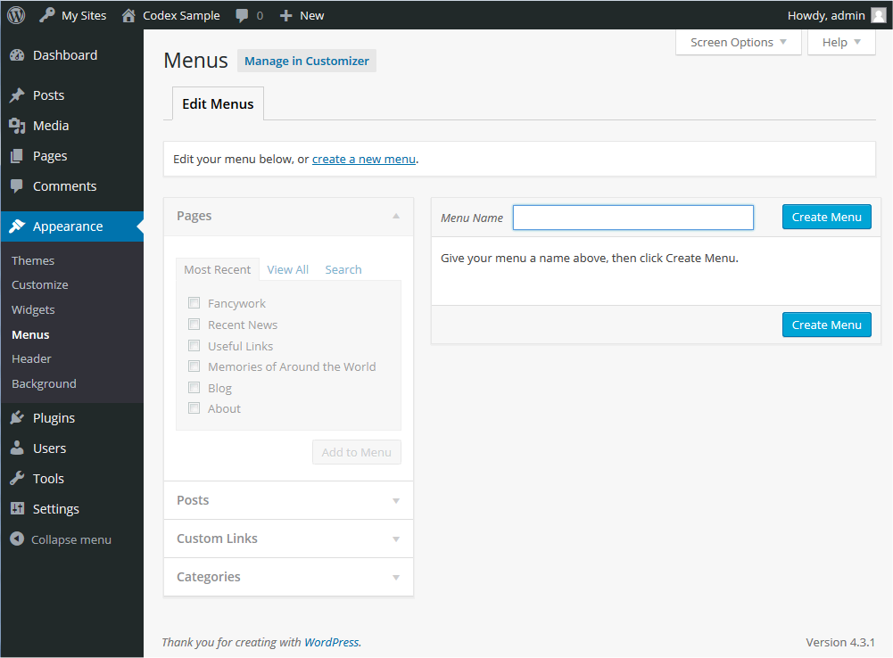
How to Create, Add, & Edit a WordPress Navigation Menu continue

Slide 242
Adding Items to a Menu
You can add different link types into your menu, these are split between panes left of the menu you're currently editing.
Locate the pane entitled Pages.
Within this pane, select the View All link to bring up a list of all the currently published Pages on your site.
Select the Pages that you want to add by clicking the checkbox next to each Page's title.
Click the Add to Menu button located at the bottom of this pane to add your selection(s) to the menu that you created in the previous step.
Click the Save Menu button once you've added all the menu items you want.
Your custom menu has now been saved.

Slide 243
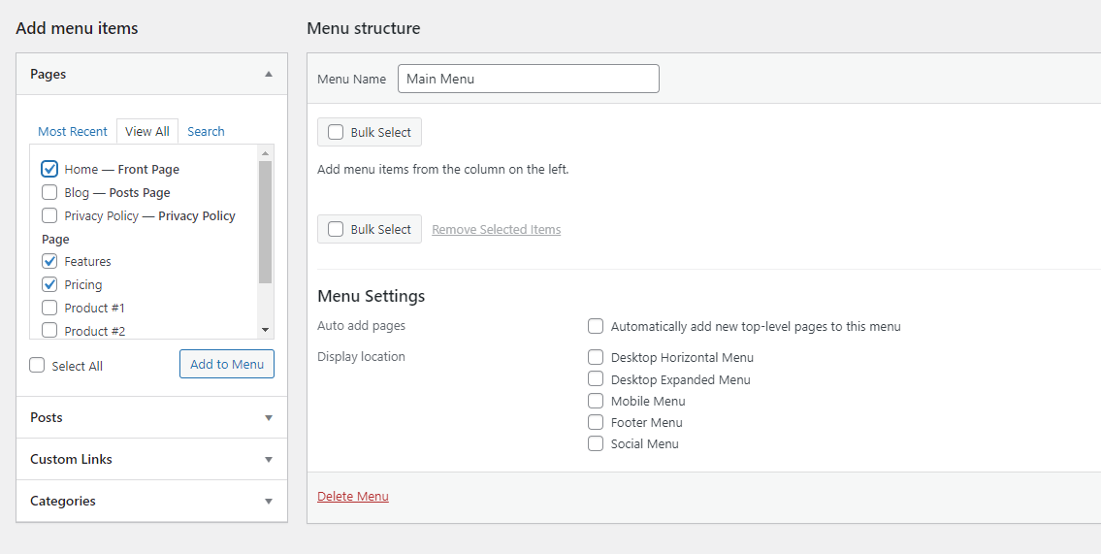
Adding Items to a Menu continue

Slide 244
How to edit a menu in WordPress
Need to edit an existing menu on a WordPress site? If you have only one menu, just go to the Appearance → Menus screen, and it will be right there on the page, ready to be customized.
If you have multiple menus, you’ll see the Select a menu to edit dropdown near the top of the page. Pick the one you want, then click Select to load it.
If you’re using the Theme Customizer, you’ll see a list of all your existing menus at the top as soon as you open the Menus screen. Just click the one you want to open.

Slide 245
Deleting a Menu Item
Locate the menu item that you want to remove in the menu editor window
Click on the arrow icon in the top right-hand corner of the menu item/box to expand it.
Click on the Remove link. The menu item/box will be immediately removed.
Click the Save Menu button to save your changes.

Slide 246
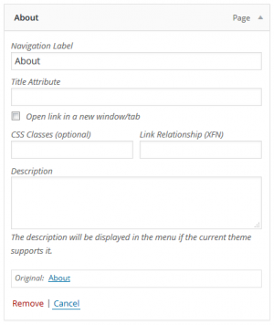
Customizing Menu Items
Navigation Label
This field specifies the title of the item on your custom menu. This is
what your visitors will see when they visit your site/blog.
Original
A link to the original source of the menu item (e.g. a link to view the
post or page). Following items are hidden by default. Use Screen Options
to show the required fields.
Title Attribute
This field specifies the Alternative ('Alt') text for the menu item. This text
will be displayed when a user's mouse hovers over a menu item.
Link Target
Select "Same window or tab" or "New window or tab" from the pulldown.
CSS Classes
Optional CSS Classes for this menu item

Slide 247
Customizing Menu Items continue
Link Relationship (XFN)
Allows for the generation of XFN attributes automatically so you
can show how you are related to the authors/owners of site to
which you are linking. See Link Relationship for details.
Description
Description for this link. The description will be displayed in the
menu if the current theme supports it.
Click on the arrow in the top right-hand corner of the menu item to
expand it.
Enter the values for the required fields that you want to assign to
the item.
Click the Save Menu button to save your changes.

Slide 248
Creating Multi-level Menus
When planning the structure of your menu, it helps to think of each menu item as a heading in a formal report document. In a formal report, main section headings (Level 1 headings) are the nearest to the left of the page; sub-section headings (Level 2 headings) are indented slightly further to the right; any other subordinate headings (Level 3, 4, etc) within the same section are indented even further to the right.
The WordPress menu editor allows you to create multi-level menus using a simple 'drag and drop' interface. Drag menu items up or down to change their order of appearance in the menu. Drag menu items left or right in order to create sub-levels within your menu.
To make one menu item a subordinate of another, you need to position the 'child' underneath its 'parent' and then drag it slightly to the right.
Position the mouse over the 'child' menu item.
Whilst holding the left mouse button, drag it to the right.
Release the mouse button.
Repeat these steps for each sub-menu item.
Click the Save Menu button in the Menu Editor to save your changes.

Slide 249
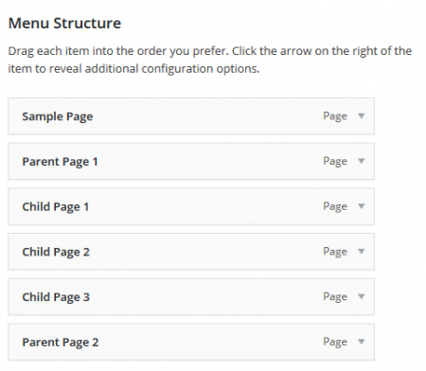
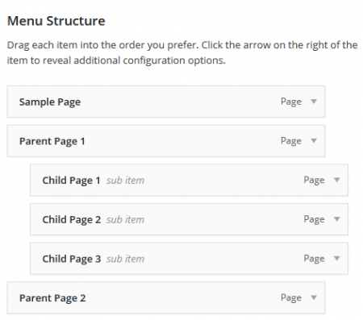
Creating Multi-level Menus continue

Slide 250
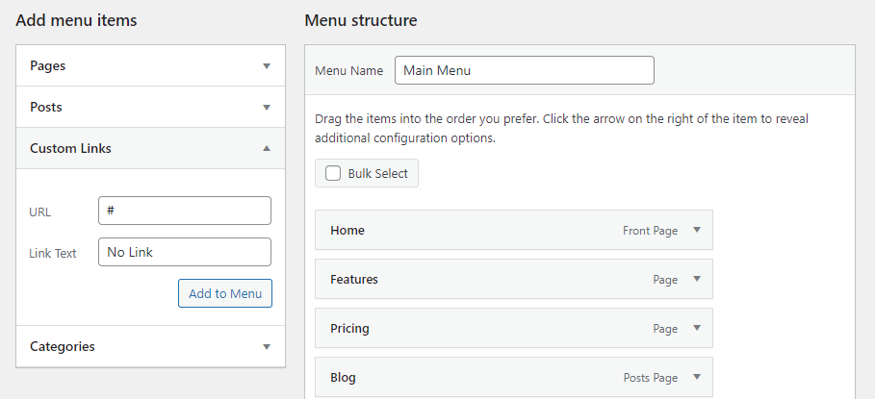
Add a menu item without a link
Most of the time, you’ll want your menu items to link to a page. But sometimes, like when creating a dropdown menu, you just want the top-level link to be text and nothing else.
To do this, create a Custom Link like normal, but instead of inserting a link, insert the # symbol. Then title the menu item as usual and click Add to Menu. You can leave the # symbol if you want, or you can open your new menu item, delete the symbol, and click Save Menu.

Slide 251
Adding Your Menu to Your Site
If your current theme supports custom menus, you will be able to add your new menu to one of the Theme Locations.
Scroll to the bottom of the menu editor window.
In the section titled Theme locations, click the check box for the location where you want your menu to appear.
Click Save menu once you've made your selection

Slide 252
How to create a menu
You may follow the links below for video guides:
https://www.youtube.com/watch?v=8goOipNnb3I
https://www.youtube.com/watch?v=AneZEWEHpuw
https://www.youtube.com/watch?v=wzz60tlBZLQ

